Slide 1
Next-Level Accommodation and ADA Challenges
Job Accommodation Network (JAN) Accommodation and Compliance webcast Series Tracie DeFreitas, M.S., JAN Principal Consultant, ADA Specialist

Slide 2
Housekeeping
Technical Difficulties
Q&A option at the bottom of the screen
800-526-7234 or 877-781-9403 (TTY) - or Live Chat at AskJAN.org
Frequently Asked Questions (FAQ) https://AskJAN.org/Training/JAN-Webcast-Frequently-Asked-Questions.cfm
Questions for Presenters
Q&A option at the bottom of the screen

Slide 3
Housekeeping 2
PPT Slides
Click the link included in the webcast login email you received
Captioning
Use the closed caption (CC) option or StreamText link shared in the webcast chat
Transcript will be available with webcast archive

Slide 4
Discussion Topics
Accommodation and ADA Challenges
Engaging in the Interactive Process
Leave and Attendance
Performance and Conduct
Policies
COVID-19 Pandemic Issues
Miscellaneous

Slide 5
Next-level Challenges: Training Strategy
Challenges
Examples
Situations
Novice-Level Failure
Next-Level Solutions

Slide 6
Engaging in the interactive Process
Challenges: Communication breakdown, lack of engagement, no cooperation
Examples
Employer stuck waiting for medical information
Employee refused effective accommodation
No communication from employee when absent/on leave
Uninformed decision makers

Slide 7
Next-Level Solutions: IP – Situation 1
Situation 1: Employer stuck waiting for medical information
Novice-Level Strategy
Deny accommodation due to lack of sufficient information
Next Level
Decide what information is necessary
Offer deadline extension
Ask job-related questions to address specific issues
Document effort to obtain information
JAN’s Avoiding “The Waiting Place” After Requesting Medical Information

Slide 8
Next-Level Solutions: IP – Situation 2
Situation 2: Employee refused effective accommodation
Novice-Level Strategy
End the interactive process
Next Level
Find out why the accommodation was refused
Consider employee preference
Explore other effective solutions, if willing
Document employee refusal of accommodation
Good faith? May end interactive process

Slide 9
Leave and Attendance
Challenges: Intermittent leave, extended leave, navigating multiple federal, state, and local leave requirements
Examples
Frequent unplanned disability-related absences
Exhausted FMLA and leave is still needed
Repeated extensions of leave
Indefinite leave request related to COVID-19

Slide 10
Next-Level Solutions: Leave and Attendance – Situation 1
Situation 1: Frequent unplanned disability-related absences
Novice-Level Strategy
Only apply the attendance policy
Next Level
How can I help?
Gather information about estimated frequency and duration of future absences
Apply FMLA, other requirements…then ADA
Accommodate if reasonable
Document the impact of leave to assess undue hardship

Slide 11
Next-Level Solutions: Leave and Attendance – Situation 2
Situation 2: Indefinite leave request related to COVID-19
Novice-Level Strategy
Approve indefinitely OR not at all
Next Level
Check employer policies/practices and federal, state, local COVID-19 requirements
Indefinite leave not required under ADA but can allow
Approve leave in increments
May choose to end indefinite leave
Explore alternative accommodations to return to work

Slide 12
Performance and Conduct
Challenge: Balancing ADA compliance with meeting standards/business needs
Examples
Last minute request for accommodation/disclosure
Unaddressed performance issues and a new supervisor
Addressing strange behavior/conduct
Telework accommodation request from a poor performer

Slide 13
Next-Level Solutions: Performance – Situation 1
Situation 1: Last minute request for accommodation/disclosure during review
Novice-Level Strategy
Disregard disclosure/request and terminate
Next Level
Proceed with performance discussion
If disciplinary action is something other than termination, engage in IP/gather information
Postpone performance improvement plan (PIP)
Explore and implement reasonable accommodations and then reinstate PIP
Devise anonymous coding system that doesn’t reveal specific disability-related information in evaluation

Slide 14
Next-Level Solutions: Performance – Situation 2
Situation 2: Unaddressed performance issues and a new supervisor
Novice-Level Strategy
Ignore issues OR let employee go
Next Level
Review job description/essential functions/standards
Proceed with performance discussion and document
Engage in IP and gather medical information, if needed
Explore and implement reasonable accommodations and monitor accommodations and performance
JAN’s Out with the Old, In with the New...Supervisor

Slide 15
Next-Level Solutions: Performance – Situation 3
Situation 3: Telework accommodation request from a poor performer
Novice-Level Strategy
Deny due to poor performance
Next Level
Gather information about why employee believes telework will improve performance
Can explore alternative accommodation solutions
Set goals, expectations, supervision plan for telework
Implement as a trial accommodation
Monitor accommodation and review performance

Slide 16
Policies
Challenge: Accommodations may be apparent or affect others
Examples
Modifying a ‘no animals’ policy – service dog access/severe allergy/phobia
Implementing a ‘no fragrance’ policy – rights controversy
Modifying a policy related to where work is performed – telework as an accommodation
Implementing a ban on certain foods

Slide 17
Next-Level Solutions: Policies – Situation 1
Situation 1: Modifying a ‘no animals’ policy – service dog access/severe allergy/phobia
Novice-Level Strategy
No dogs allowed!
Next Level
Address accommodation needs individually
Explore accommodation solutions to address individual needs, circumstances, job duties, etc.
JAN’s Service Animals and Allergies in the Workplace

Slide 18
Next-Level Solutions: Policies – Situation 2
Situation 2: Implementing a ‘no fragrance’ policy – rights controversy
Novice-Level Strategy
We can’t tell employees not to wear fragrances at work
Next Level
Note dress, grooming, hygiene codes
Consider implementing a ‘no fragrance’ policy
Educate workforce about the effects of fragrance use
Explore and implement reasonable accommodations
JAN’s Can’t Ban Fragrances? Consider a Fragrance Free Zone

Slide 19
Next-Level Solutions: Policies – Situation 3
Situation 3: Modifying a policy related to where work is performed – Telework
Novice-Level Strategy
Manager doesn’t want employees to work at home
Next Level
Gather disability-related information about telework need
Consider as accommodation even if others are not allowed, if reasonable
May choose other effective reasonable accommodations
Implement as a trial or temporary accommodation
Note policy of assisting any employee having difficulties; workplace issues are personal; respect employee privacy

Slide 20
Pandemic Issues
Challenges: Multifaceted issues; continuously evolving; multiple federal, state, local requirements; worker safety
Examples
Removing essential functions in a pandemic
Mask-related accommodation requests
Telework, isolation, and mental health conditions
COVID-19 vaccination requirements

Slide 21
Next-Level Solutions: Pandemic Issues – Situation 1
Situation 1: Removing essential functions in a pandemic
Novice-Level Strategy
Remove essential functions indefinitely
Next Level
Adapt with evolving pandemic circumstances
Can temporarily excuse; does not mean a job’s essential functions are permanently changed, will always be feasible, or does not pose undue hardship
No obligation to refrain from restoring essential duties
Choose an end date, review, continue, or reinstate

Slide 22
Next-Level Solutions: Pandemic Issues – Situation 2
Situation 2: Mask-related accommodation requests
Novice-Level Strategy
Wear a mask or don’t come to work
Next Level
Engage in IP to gather information about why cannot wear a mask to determine whether ADA applies
Be mindful of state/local mandates
Explore and implement effective accommodations – worker safety is the priority
Can exclude from the workplace if cannot safely work w/wo accommodation
JAN’s Masks for COVID-19 Management and ADA Accommodations

Slide 23
Next-Level Solutions: Pandemic Issues – Situation 3
Situation 3: Telework, isolation, and mental health
Novice-Level Strategy
Failure to communicate and understand
Next Level
Be intentional – reach out, set regular check-ins, meet via video
Set expectations, provide written guidance, communicate changes early
Create opportunities to connect with co-workers
Explore accommodations for returning to work

Slide 24
Next-Level Solutions: Pandemic Issues – Situation 4
Situation 4: Impact of COVID-19 vaccination on continuing accommodations
Novice-Level Strategy
Get vaccinated and return to work
Next Level
Address each accommodation situation case-by-case
Gather relevant information to inform accommodation decision – not one size fits all
Explore effective and reasonable accommodations to return to the workplace
Consider telework if cannot safely return to the workplace with accommodations

Slide 25
Next-Level Solutions: Pandemic Issues – Situation 5
Situation 5: Request for exception from COVID-19 vaccination requirement
Novice-Level Strategy
Get vaccinated or be terminated
Next Level
Gather relevant information to determine whether the ADA or Title VII applies
Explore effective and reasonable accommodations to return to the workplace
Consider telework if cannot safely return to the workplace with accommodations

Slide 26
Next-Level Solutions: Pandemic Issues – Situation 6
Situation 6: Request to continue teleworking as an accommodation
Novice-Level Strategy
No, everyone must return to the workplace
Next Level
Gather relevant information to determine if the individual has a disability
Assess whether the job has changed and if essential functions can be performed
Mandatory telework because of the pandemic could serve as a trial period
Consider a hybrid work arrangement if 100% is not reasonable
JAN’s Practical Approach to Telework as a Reasonable Accommodation During the Pandemic

Slide 27
Miscellaneous
Challenges: Lifting restrictions, interacting/communicating with supervisor, commuting/access barriers
Examples
Back injury or pregnancy and lifting restrictions
Getting along with a supervisor
Limited access to parking

Slide 28
Next-Level Solutions: Miscellaneous – Situation 1
Situation 1: Back injury or pregnancy and lifting restrictions
Novice-Level Strategy
Leave until 100% healed/able to lift
Next Level
Explore accommodations to perform essential functions consistent with restrictions
Consider modified duty
Implement a temporary accommodation – document
Reassignment or leave as last resort

Slide 29
Next-Level Solutions: Miscellaneous – Situation 2
Situation 2: Difficulty getting along with a supervisor
Novice-Level Strategy
Change supervisor
Next Level
New supervisor may not be reasonable – but not prohibited
Consider whether this is an isolated situation or a pattern
Change supervisory methods as accommodation
JAN’s Changing a Supervisor as an Accommodation

Slide 30
Next-Level Solutions: Miscellaneous – Situation 3
Situation 3: Limited access to parking
Novice-Level Strategy
Required number of spaces met, nothing we can do
Next Level
ADA Standards are a minimum requirement – accommodation may be necessary to meet the needs of a particular employee
Explore and implement reasonable accommodations to address the commuting barrier/access issue
JAN’s A to Z by Topic: Parking

Slide 31
Questions? Contact JAN for More Information
Visit
AskJAN.org
Call
800.526.7234
877.781.9403 (TTY)
Chat
@ AskJAN.org
Submit
JAN on Demand Inquiry @ AskJAN.org/JANonDemand.cfm
Email
JAN@AskJAN.org
Social Media
Facebook – Job Accommodation Network
Twitter – @JANatJAN

Slide 32
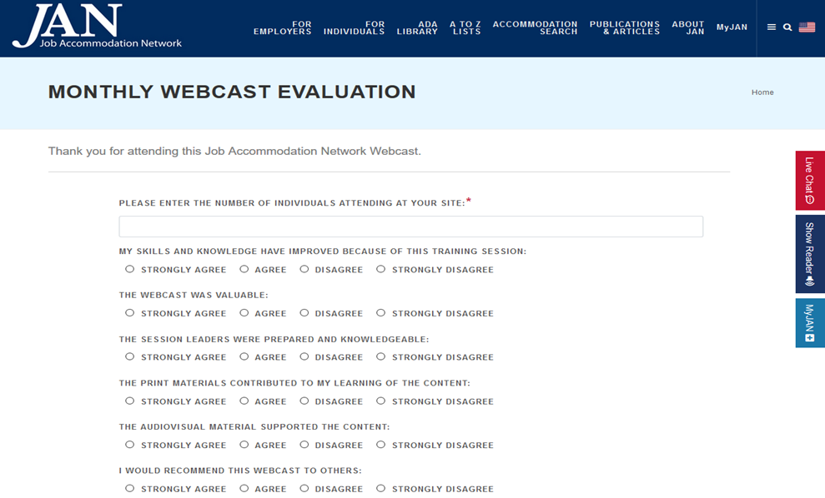
How do I claim the HR CEU?
Don’t close the JAN webcast browser
CEU approval code will be provided via the certificate that comes up after completing the webcast evaluation
Thank you for attending!

Slide 33
AskJAN.org Resources
Employers' Practical Guide to Reasonable Accommodation Under the ADA https://AskJAN.org/publications/employers/employers-guide.cfm
Interactive Process https://AskJAN.org/topics/interactive.cfm
Recognizing an Accommodation Request https://AskJAN.org/articles/Recognizing-an-Accommodation-Request-Under-the-ADA.cfm
Providing Temp/Trial Accommodation Solutions https://AskJAN.org/topics/Temporary-Accommodations.cfm

Slide 34
AskJAN.org Resources 2
A to Z of Disabilities and Accommodations https://AskJAN.org/a-to-z.cfm
Avoiding “The Waiting Place” After Requesting Medical Information https://AskJAN.org/blogs/jan/2016/05/avoiding-the-waiting-place-after-requesting-medical-information.cfm
Out with the Old, In with the New...Supervisor https://AskJAN.org/articles/Out-with-the-Old-and-In-with-the-New-Supervisor.cfm
Service Animals and Allergies in the Workplace https://AskJAN.org/publications/consultants-corner/vol02iss01.cfm

Slide 35
AskJAN.org Resources 3
Can’t Ban Fragrances? Consider a Fragrance Free Zone https://AskJAN.org/articles/Fragrance-Free-Zone.cfm
Coronavirus Disease 2019 (COVID-19) https://AskJAN.org/topics/COVID-19.cfm
Masks for COVID-19 Management and ADA Accommodations https://AskJAN.org/articles/Masks-for-COVID-19-Management-and-ADA-Accommodations.cfm
ADA/Accommodation Lessons Learned: COVID-19 Edition https://AskJAN.org/articles/ADA-and-Accommodation-Lessons-Learned-COVID-19-Edition.cfm

Slide 36
AskJAN.org Resources 4
JAN’s A to Z by Topic: Telework https://AskJAN.org/topics/telework.cfm
Practical Approach to Telework as a Reasonable Accommodation During the Pandemic https://AskJAN.org/articles/A-Practical-Approach-to-Telework-as-a-Reasonable-Accommodation-During-the-Pandemic.cfm
Changing a Supervisor as an Accommodation https://AskJAN.org/articles/Changing-a-Supervisor-as-an-Accommodation-under-the-ADA.cfm
JAN’s A to Z by Topic: Parking https://AskJAN.org/topics/parking.cfm

Slide 37
EEOC Resources
Applying Performance and Conduct Standards to Employees with Disabilities https://www.EEOC.gov/laws/guidance/applying-performance-and-conduct-standards-employees-disabilities
Reasonable Accommodation and Undue Hardship Under the ADA https://www.EEOC.gov/laws/guidance/enforcement-guidance-reasonable-accommodation-and-undue-hardship-under-ada
What You Should Know About COVID-19 and the ADA, the Rehabilitation Act, and Other EEO Laws https://www.EEOC.gov/wysk/what-you-should-know-about-covid-19-and-ada-rehabilitation-act-and-other-eeo-laws

