Slide 1
Accommodating
Public Safety Workers with Disabilities
JAN Motor Team
Lisa Mathess, Lead Consultant
Matthew McCord, Senior Consultant
Tatum Storey, Consultant

Slide 2

JAN Webcast Housekeeping
Technical Difficulties
  Use the Q&A option at the bottom of the screen
  Use the Live Chat at AskJAN.org
  Access Frequently Asked Questions
  https://AskJAN.org/training/Frequently-Asked-Questions-About-JAN-s-Remote-Trainings.cfm
Questions for Presenters
  Use the Q&A option at the bottom of the screen
  Gathered into a queue
  Time permitting, answered at the end

Slide 3

Housekeeping Cont’d
PPT Slides
  See the link included in the webcast chat
  Download from the Webcast Archive section
  of the Training page at AskJAN.org
Captioning
  Use the closed caption
  option at the bottom of the screen
  Transcript will be available with webcast archive
This event is being recorded
Please complete the evaluation at the end

Slide 4

Public Safety Workers
Employees who protect the health,
safety, and welfare of the public
Law enforcement officers
lifeguards
park rangers
firefighters
ambulance and rescue personnel
communications and dispatch specialists
other emergency service providers charged with maintaining the public safety

Slide 5
Public Safety Workers
ADA vs other Federal Laws
The ADA will defer to the other federal law
  OSHA
  DOT
  FLSA
Must be required not recommended/suggested
Still consider accommodations per ADA
ADA vs State and Local Laws
Direct threat analysis, reasonable accommodation
ADA Technical Assistance Manual, title I,
4.6 Health and Safety Requirements of Other Federal or State Laws

Slide 6
Public Safety Workers
Fire & Wildland Fire Service

Slide 7
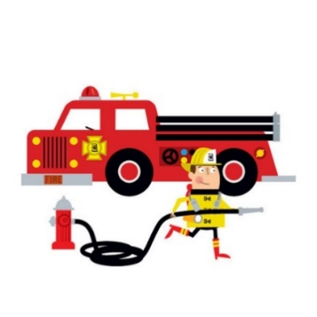
Fire & Wildland Fire Service
Overview:
Volunteers vs. Employed, who is covered by the ADA?
Common accommodation solutions:
  Limited scheduling/modified schedule
  Job restructuring/limiting tasks
  Policy modification to the dress code/safety standards
  Products to support employees with disabilities
  Overnight accommodations
    Seniority systems and sleeping arrangements
  Case study example

Slide 8
Fire & Wildland Fire Service
Volunteer vs Employee
Under Title I, only individuals with disabilities who meet the definition of "employee" are entitled to reasonable accommodations
  A volunteer is typically not a protected employee under Title I of the ADA because an employer-employee relationship usually is not formed
  However, if a volunteer receives “significant remuneration” (e.g., pay and benefits) as a result of volunteer service or the volunteer service usually leads to employment with the employer, then the volunteer may be considered an employee
Volunteers and the Americans with Disabilities Act (ADA)

Slide 9

Fire & Wildland Fire Service
Limiting Overtime/Modification to a Schedule
A modified schedule may involve:
adjusting arrival or departure times
providing periodic breaks
altering when certain functions are performed
allowing an employee to use accrued paid leave
providing additional unpaid leave
Enforcement Guidance:
Reasonable Accommodation and Undue Hardship Under the ADA

Slide 10

Fire & Wildland Fire Service
Limiting Overtime/Modification to a Schedule
Common conflicts or nuances with modification to
a schedule:
Time requirements for essential function(s) to be performed
  Undue hardship issues
  Reassignment
Overtime Restrictions and the ADA
Workin’ 9 to 5 – Not the Only Way to Make a Living
Overtime
How will technology change tomorrow’s firefighting PPE?

Slide 11
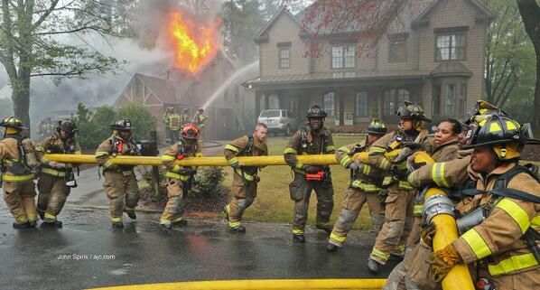
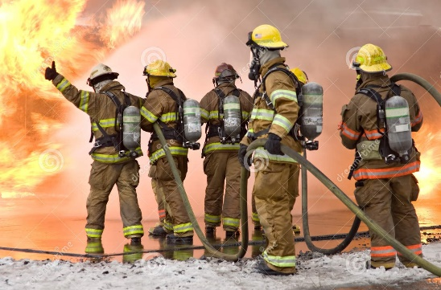
Fire & Wildland Fire Service
Job Restructuring
Marginal functions vs essential functions
Factors to consider in
determining if a function is essential include:
  whether the reason the position exists
  is to perform that function,
  the number of other employees available
  to perform the function or among whom
  the performance of the function can
  be distributed, and
  the degree of expertise or skill
  required to perform the function.
Enforcement Guidance:
Reasonable Accommodation and Undue Hardship Under the ADA

Slide 12
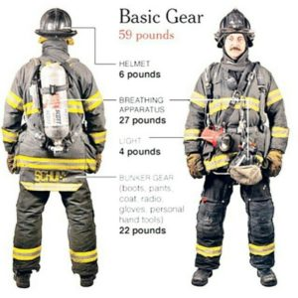
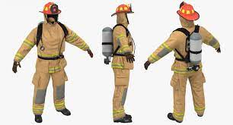
Fire & Wildland Fire Service
Policy Modification & Dress Code
Employers may require that employees observe safety and operational rules enacted to protect workers from dangers inherent in certain workplaces (e.g., factories with machinery with accessible moving parts)
Conduct rules must be job-related and consistent with business necessity when applied to an employee whose disability caused them to violate the rule
Enforcement Guidance:
Applying Performance and Conduct Standards to Employees with Disabilities

Slide 13
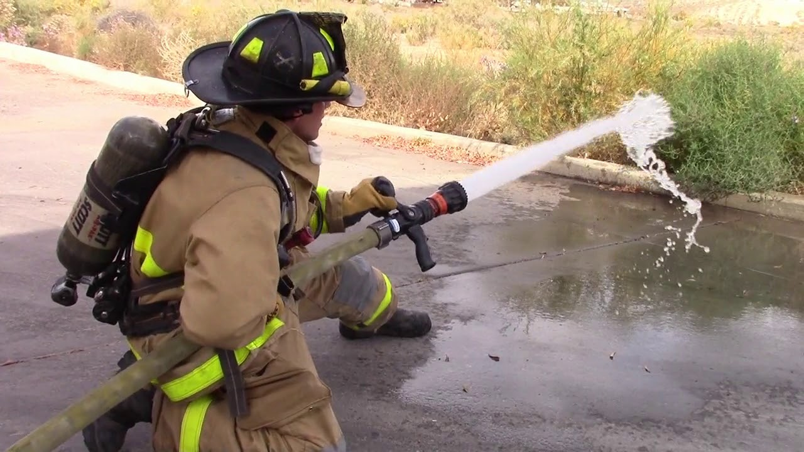
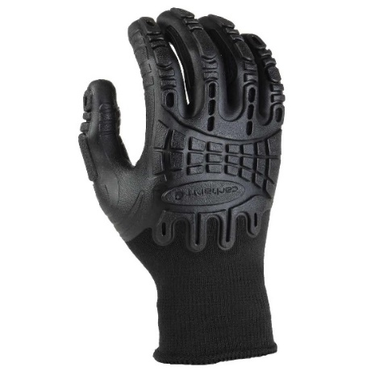
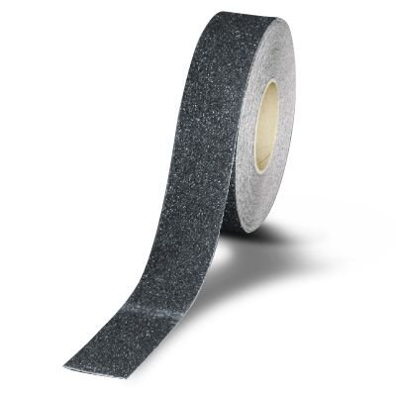
Fire & Wildland Fire Service
Product Examples & Solutions
Handling accommodation examples:
  Grip tape for tools to enhance handling and gripping
  Extra grip gloves
  Proper hose handling techniques

Slide 14
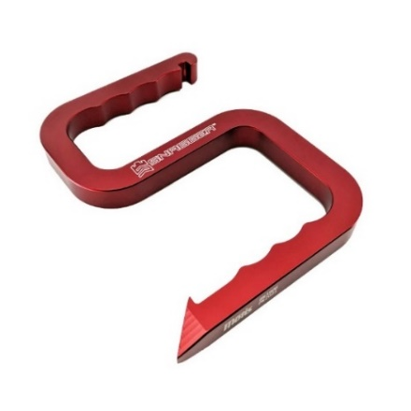
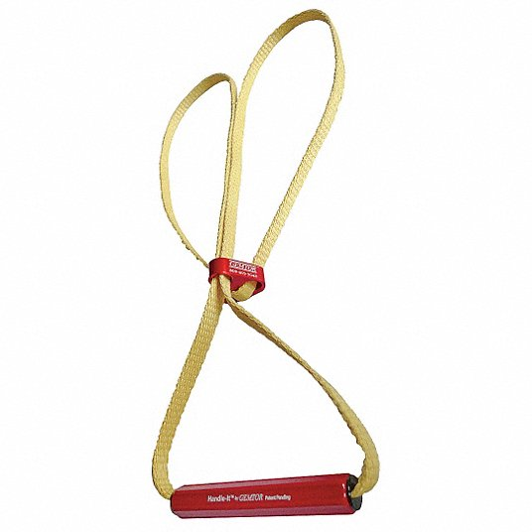
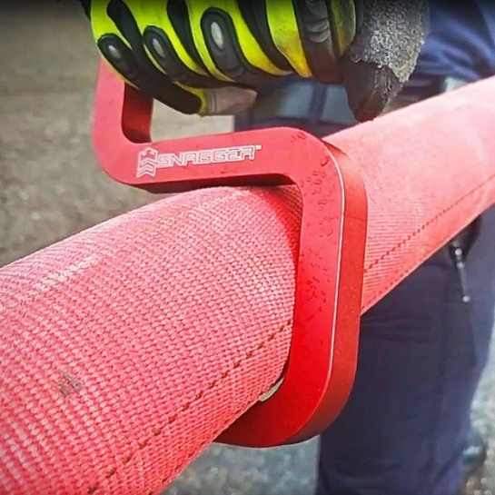
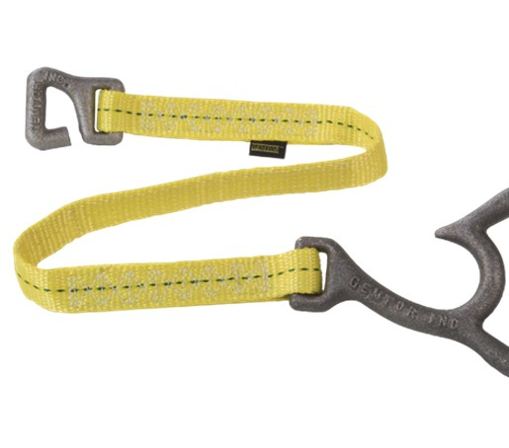
Fire & Wildland Fire Service
Product Examples:
Lifting and carrying product examples:

Slide 15
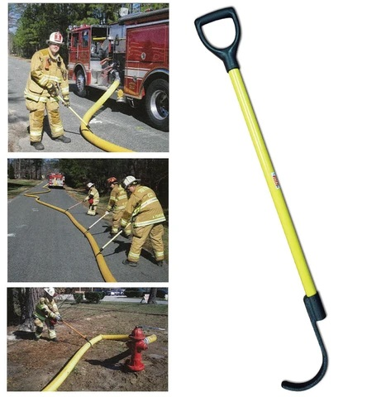
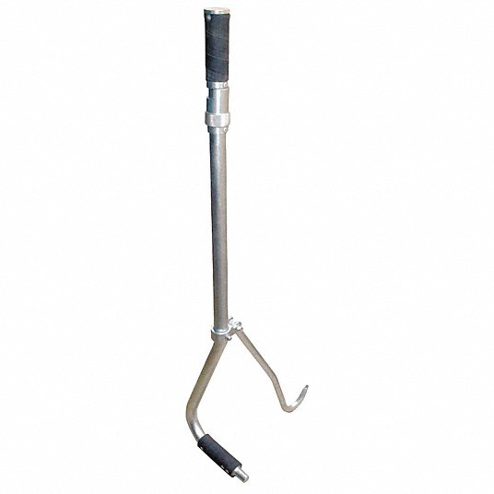
Fire & Wildland Fire Service
Product Examples:
Hose Hooks
Reachers
Lid Lifters

Slide 16
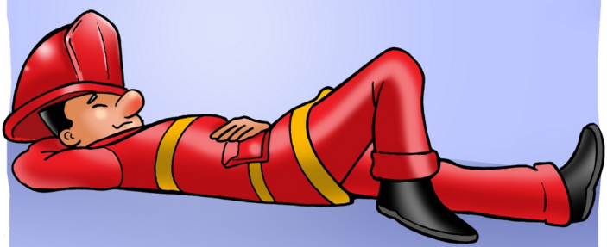
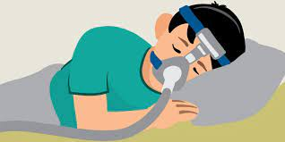
Fire & Wildland Fire Service
Overnight accommodation concerns:
Policy modification
Sleep disorders
  Insomnia
  Sleep Apnea
  Restless Leg Syndrome
  Narcolepsy
Developing a plan of action
  JAN’s Sample Plan of Action

Slide 17
Fire & Wildland Fire Service
JAN Study Example
Robert works as a firefighter and has developed arthritis along his spine. Robert has difficulty bending for prolonged periods of time and would like to request accommodations to limit bending, when possible, to reduce pain. Robert also requires a CPAP machine to sleep at night that is loud and intrusive.

Slide 18
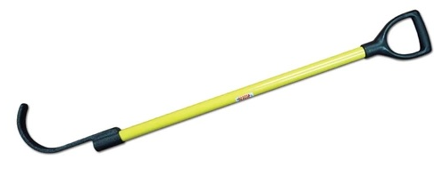
Fire & Wildland Fire Service
Accommodation
Robert’s fire chief works with Robert through an interactive process and offers a hose hook and job restructuring on the field. The chief also offers Robert a corner spot in the sleeping quarters so that Robert can use his CPAP machine and not disturb others. Coworkers who enjoy sleeping to white noise agree to sleep closest to Robert to limit disruptions to other firefighters who are light sleepers. A plan of action is also developed so that if any firefighters see Robert sleeping when duty calls, they can tap on his shoulder and wake him.

Slide 19

Fire & Wildland Fire Service
Cost: One-time cost $88
Benefit: By making these accommodations, the employer maintained compliance with the ADA and made their employee and manager happy.

Slide 20
Public Safety Workers
Law Enforcement/Corrections

Slide 21

Law Enforcement/Corrections
Medical Exams & Inquiries
JAN’s Medical Exams and Inquiries
EEOC’s Disability-Related Inquires and Medical Exams of Employees
Dept of Justice Questions & Answers: The ADA and Hiring Police Officers

Slide 22
Law Enforcement/Corrections
When is a disability-related inquiry or exam job-related and consistent with business necessity?
When there is a reasonable belief, based on objective evidence, that:
  performance of job functions will be/is impaired by a
  medical impairment
  or there is a direct threat due to a known medical impairment
After accommodation is requested – when disability and/or need for accommodation is not known/obvious
Exams for public safety positions (e.g., police, fire)
When there is a known disability that is affecting performance/conduct – but no RA request has been made

Slide 23
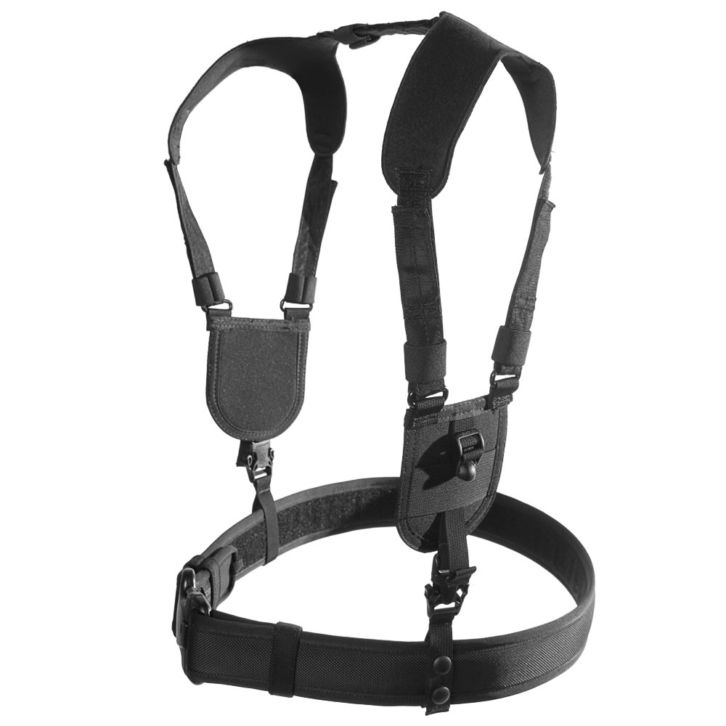
Law Enforcement/Corrections
Duty belts
Weight of equipment, placement, & force when seated
Back/Hip/Leg limitations
Pain
Alternatives
Suspenders
Vests/harness
Rearrange equipment
Dress Code

Slide 24
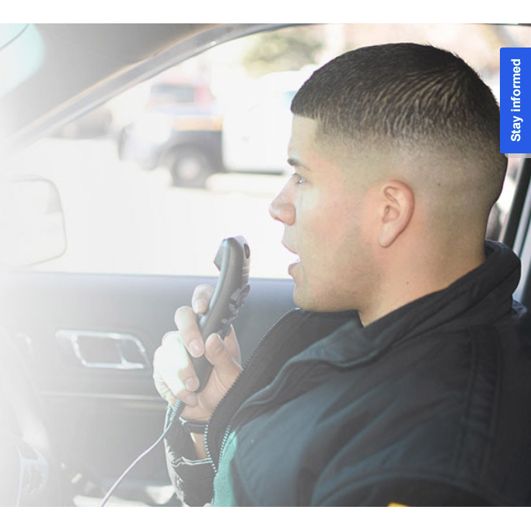

Law Enforcement/Corrections
Dragon for Law Enforcement by Nuance
Speech recognition for officers, dispatchers, & support staff
  Fine motor limitations
  Cognitive limitations: reading/writing
Dragon for Law Enforcement by Nuance

Slide 25
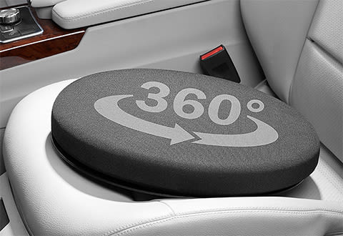
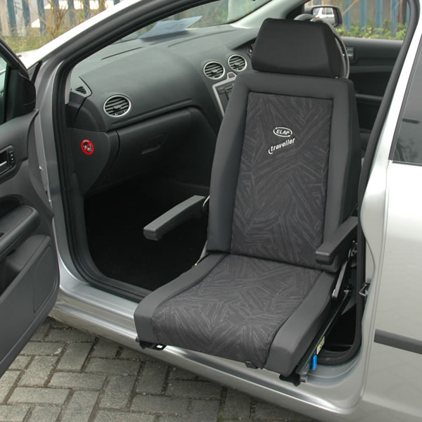
Law Enforcement/Corrections
Police Cruiser
Low profile, compact, seating options limited
  Bending limitations
  Body Size
Accommodations
Lumbar Cushions
Swivel Seats & Seat Extenders
Assist Lift Cushions
Provide SUV or larger sedan
Accommodations for Driving

Slide 26

Law Enforcement/Corrections
Corrections Officer
Restrain others
Ability to ambulate large areas
Control emotions
Accommodations
Job restructuring
Periodic breaks
What Does “Direct Threat” Mean –
A Deconstructive Series for ADA Terminology

Slide 27

Law Enforcement/Corrections
Probation Officer
Off-Site Access
Driving
Accommodations
Location change
Virtual
Pairing with co-worker who can drive

Slide 28
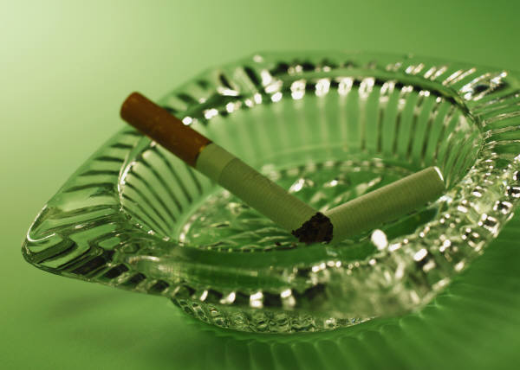
Law Enforcement/Corrections
Example
A probation officer with allergies and asthma had difficulty meeting with clients in their homes, especially clients who smoked.

Slide 29

Law Enforcement/Corrections
Accommodation
The employee was allowed to meet some of their clients in a neutral place without smoke.

Slide 30

Law Enforcement/Corrections
Cost: $0
Benefit: Kept an experienced, tenured employee.

Slide 31
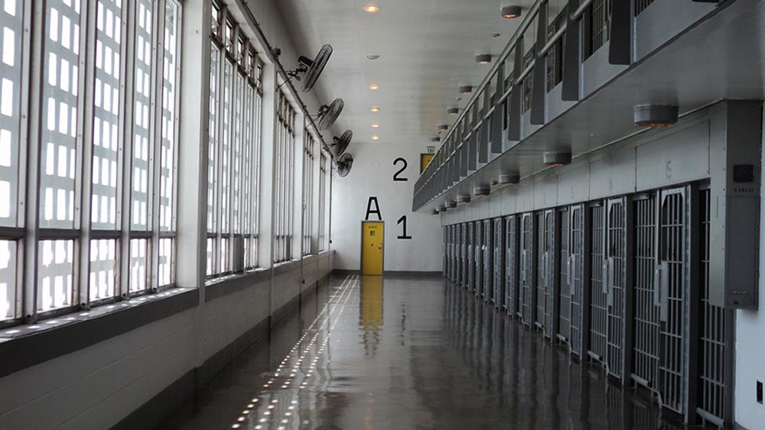
Law Enforcement/Corrections
Example
A correctional officer with a musculoskeletal disorder was having trouble performing essential functions due
to bending, sitting, and walking limitations.
The prison warden called JAN to learn about possible accommodation solutions and next steps.

Slide 32
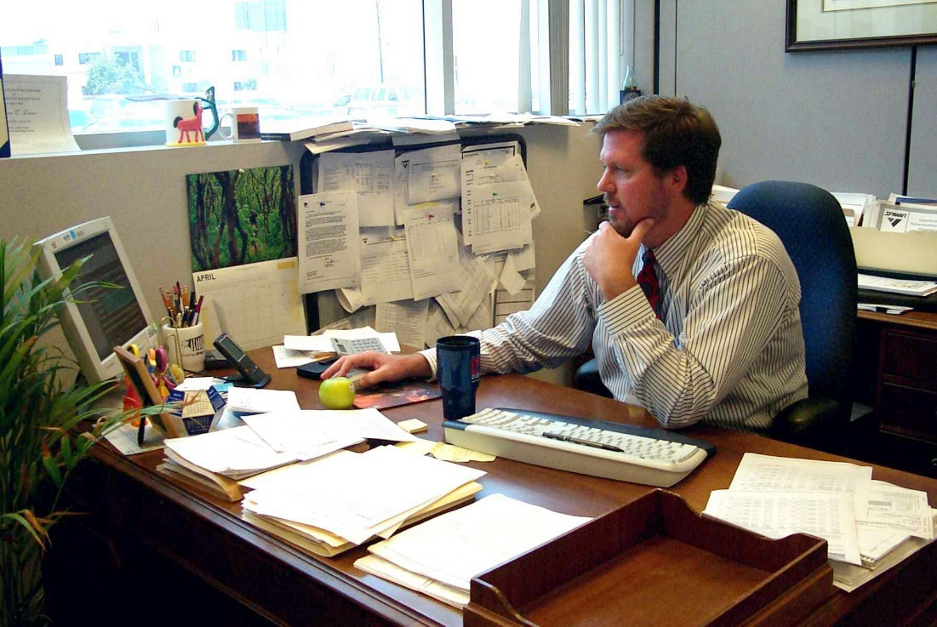
Law Enforcement/Corrections
Accommodation
The employee and prison warden both agreed that reassignment to an office role was appropriate.

Slide 33

Law Enforcement/Corrections
Cost: $0
Benefit: Retained a valued member of the team.

Slide 34
Public Safety Workers
Emergency Medical Service (EMS)

Slide 35
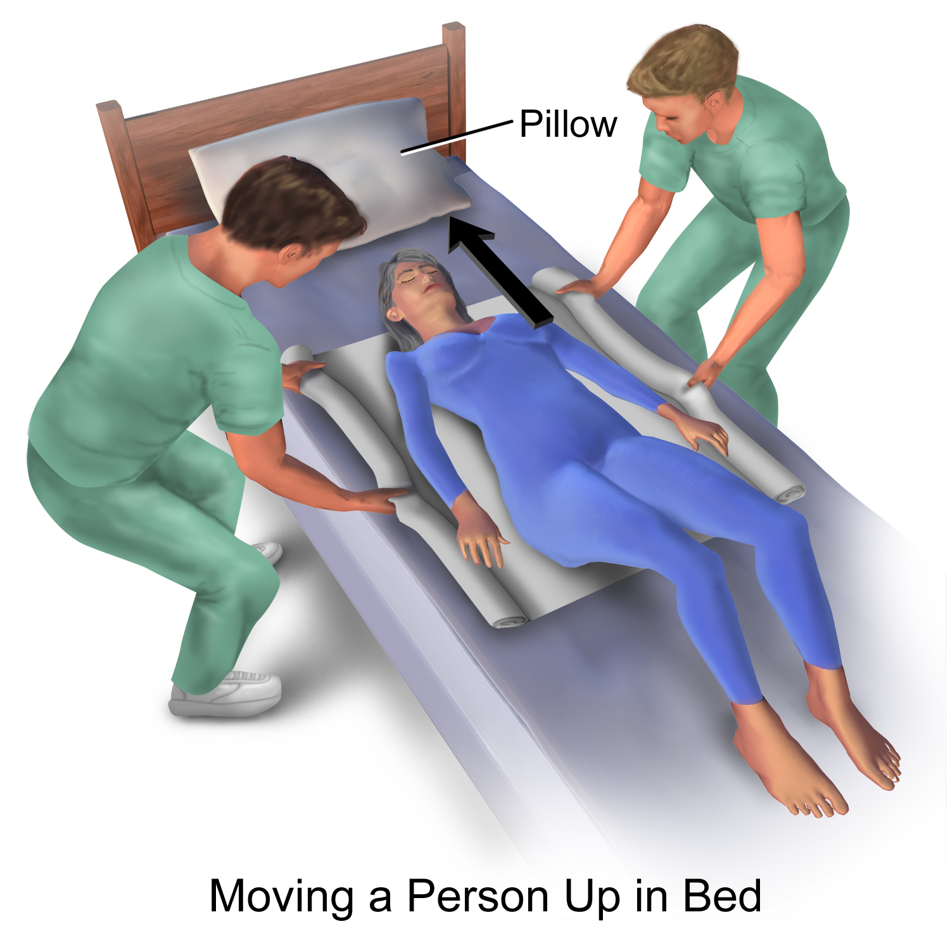
Emergency Medical Service (EMS)
Transfer Sheets
Sheets used to help move people. Often helpful for EMS workers in getting patients onto stretchers.
  Carrying limitations
  Lifting limitations
Transfer Sheets

Slide 36
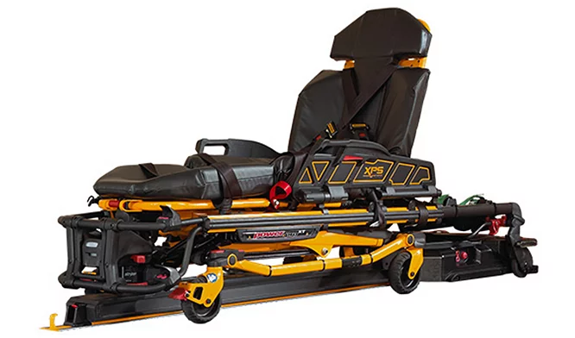
Emergency Medical Service (EMS)
Electric Ambulance Stretchers
Electronically controlled medical gurneys that reduce
the need to physically move patients.
Carrying limitations
Pushing/Pulling limitations
Electric Ambulance Stretchers

Slide 37
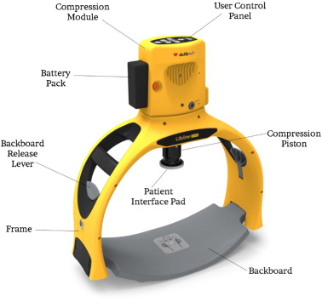
Emergency Medical Service (EMS)
Hands-Free Resuscitation Devices
Machines that perform CPR chest compressions
in place of a medical worker.
  Pushing/Pulling limitations
  Safety Standards
Hands-Free Resuscitation Devices

Slide 38
Emergency Medical Service (EMS)
COVID-19 Vaccines and Accommodations
Mere availability of vaccine does not automatically remove responsibility to provide accommodations when needed for a disability-related reason under the ADA
  Keep an open mind, do qualification standard/direct threat analysis, and use the interactive process to gather objective information about continuing reasonable accommodation
  Employers may ask questions about whether the vaccine may alter the need for reasonable accommodation – but might still need reasonable accommodation
  Avoid making accommodation decisions based on
  ‘COVID fatigue’

Slide 39
Emergency Medical Service (EMS)
JAN Study Example
An employer who was greatly encouraging employees to get flu shots due to the number of flu cases they experienced the previous year had an employee ask to forgo the injection because of a fear of needles.

Slide 40

Emergency Medical Service (EMS)
Accommodation
The employer referred the employee to a specific pharmacy in their area where needle-free shots were available.

Slide 41
Public Safety Workers
Miscellaneous

Slide 42
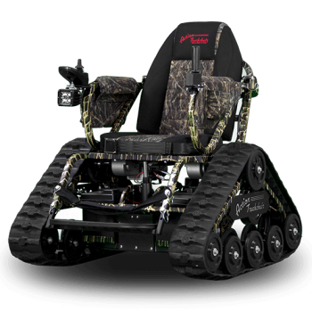
Miscellaneous
All-Terrain Scooters & Wheelchairs
Scooters designed to traverse outdoor environments, including sand, soft wet ground, uneven surfaces, curbs, and slopes.
  Standing
  Walking
  Decreased Stamina/Fatigue
All-Terrain Wheelchairs
All-Terrain Scooters

Slide 43
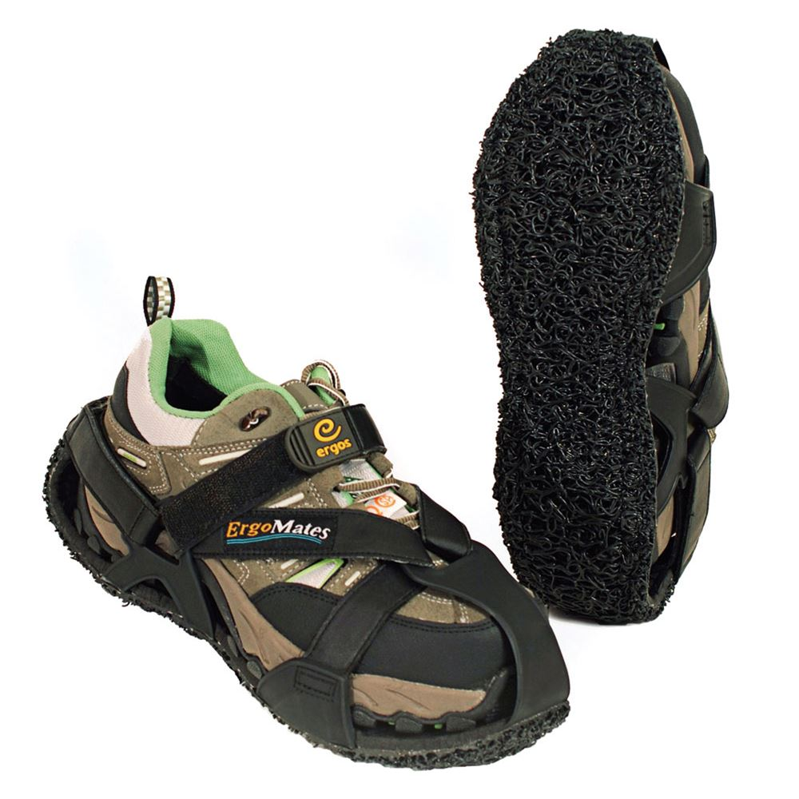
Miscellaneous
Wearable Anti-Fatigue Matting
Supportive buffers between the
wearer and the ground to provide
additional cushioning and support.
  Pain
  Standing
  Walking
Can’t Stand It? Anti-Fatigue Matting as an Accommodation
Wearable Anti-Fatigue Matting

Slide 44
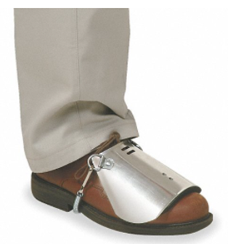
Miscellaneous
Steel Toe Shoes & Toe Guards
Footwear options designed to
provide increased protection for
the wearer.
  Safety Standards
  Standing
  Walking
The Significance of Dress Codes Under the ADA
Steel Toe Shoes & Toe Guards

Slide 45
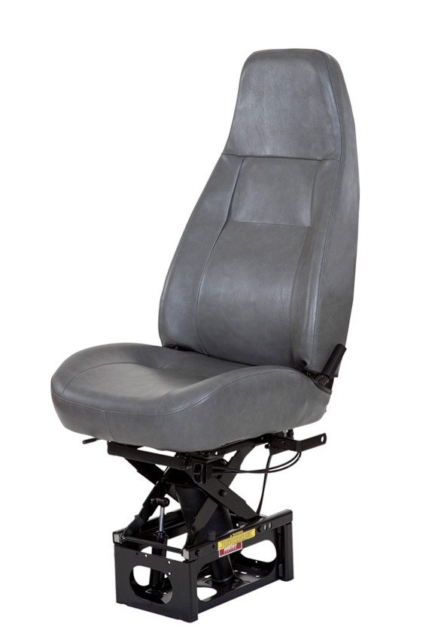
Miscellaneous
Anti-Vibration Seats
Vehicle seats designed with additional shock absorption.
  Pain
  Sitting
Accommodating Truck Drivers with Motor Impairments
Anti-Vibration Seats

Slide 46
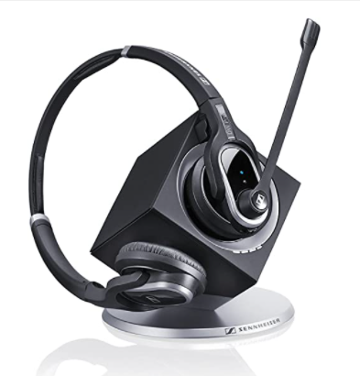
Miscellaneous
Dual-Channel Headsets
Telephone headsets designed with the
ability to switch between speaking to
multiple things at once.
Cognitive
  Fine motor
How to Train Your Dragon
Dual-Channel Headsets for Users of Speech Rec Software
Speech input data while simultaneously talking to customer via phone

Slide 47
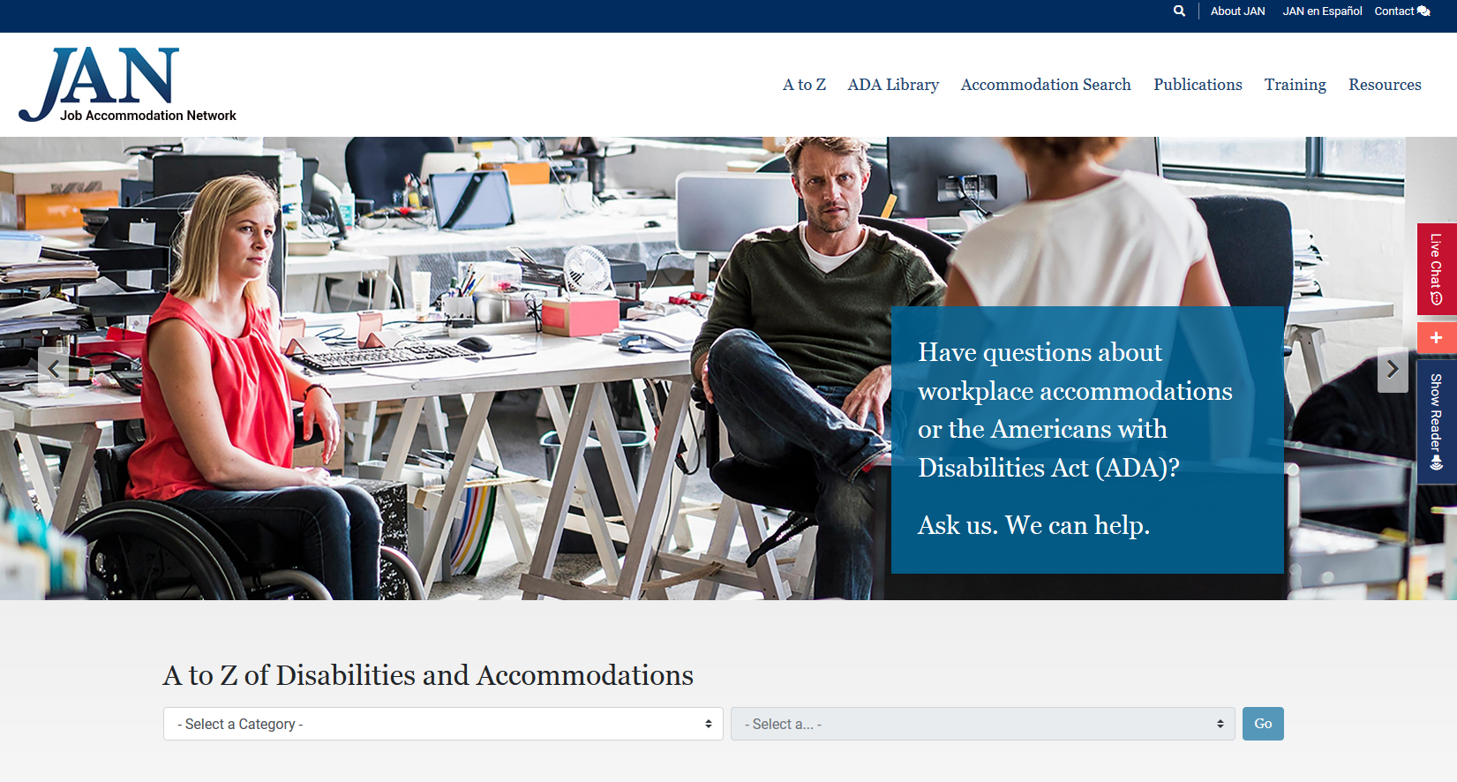

AskJAN.org

Slide 48

Questions?

Slide 49

Questions? Ask JAN!
Visit AskJAN.org
Submit a JAN on Demand question @
AskJAN.org/JANonDemand.cfm
Email JAN @ jan@AskJAN.org
Use the JAN Live Chat button @ AskJAN.org
Leave a voicemail message.
JAN staff will contact you via email or a call:
  800.526.7234 (V)
  877.781.9403 (TTY)
Connect on social media
  Facebook – Job Accommodation Network
  Twitter – @JANatJAN

Slide 50
Linked Resources
ADA Technical Assistance Manual, title I, 4.6 Health and Safety Requirements of Other Federal or State Laws
https://AskJAN.org/publications/ada-specific/Technical-Assistance-Manual-for-Title-I-of-the-ADA.cfm
Volunteers and the Americans with Disabilities Act (ADA)
https://AskJAN.org/publications/consultants-corner/vol04iss02.cfm
Enforcement Guidance: Reasonable Accommodation and Undue Hardship Under the ADA
https://www.eeoc.gov/policy/docs/accommodation.html
Overtime Restrictions and the ADA https://AskJAN.org/articles/Overtime-Restrictions-and-the-ADA.cfm

Slide 51
Linked Resources
Workin’ 9 to 5 – Not the Only Way to Make a Living https://AskJAN.org/articles/9to5.cfm
Overtime
https://AskJAN.org/concerns/Overtime.cfm
How will technology change tomorrow’s firefighting PPE? http://www.fireemsleaderpro.org/2017/08/07/technology-change-tomorrows-firefighting-ppe/
Enforcement Guidance: Applying Performance and Conduct Standards to Employees with Disabilities
https://www.eeoc.gov/laws/guidance/applying-performance-and-conduct-standards-employees-disabilities#dress
JAN’s Sample Plan of Action
https://AskJAN.org/Forms/upload/Sample-Plan-of-Action_2018.doc
JAN’s Medical Exams and Inquiries
https://AskJAN.org/topics/medexinq.cfm

Slide 52
Linked Resources
EEOC’s Disability-Related Inquires and Medical Exams of Employees
https://www.eeoc.gov/laws/guidance/enforcement-guidance-disability-related-inquiries-and-medical-examinations-employees
Dept of Justice Questions & Answers: The ADA and
Hiring Police Officers
https://www.ada.gov/copsq7a.htm
Dress Code
https://AskJAN.org/concerns/Dress-Code.cfm
Dragon for Law Enforcement by Nuance
https://www.nuance.com/dragon/industry/dragon-law-enforcement.html

Slide 53
Linked Resources
Accommodations for Driving
https://AskJAN.org/articles/Accommodations-for-Driving.cfm
Lumbar Cushions
https://AskJAN.org/solutions/Lumbar-Cushions.cfm
Swivel Seats & Seat Extenders
https://AskJAN.org/solutions/Swivel-Seats-and-Seat-Extenders.cfm
Assist Lift Cushions
https://AskJAN.org/solutions/Assist-Lift-Cushions.cfm
What Does “Direct Threat” Mean – A Deconstructive Series for ADA Terminology
https://AskJAN.org/articles/What-Does-Direct-Threat-Mean-A-Deconstructive-Series-for-ADA-Terminology.cfm

Slide 54
Linked Resources
Transfer Sheets
https://AskJAN.org/solutions/Transfer-Sheets.cfm
Electric Ambulance Stretchers
https://AskJAN.org/solutions/Electric-Ambulance-Stretchers.cfm
Hands-Free Resuscitation Devices
https://AskJAN.org/solutions/Hands-Free-Resuscitation-Devices.cfm
All-Terrain Wheelchairs
https://AskJAN.org/solutions/All-Terrain-Wheelchairs.cfm
All-Terrain Scooters
https://AskJAN.org/solutions/All-Terrain-Scooters.cfm

Slide 55
Linked Resources
Can’t Stand It? Anti-Fatigue Matting as an Accommodation at https://AskJAN.org/articles/Anti-Fatigue-Matting-as-an-Accommodation.cfm
Wearable Anti-Fatigue Matting
https://AskJAN.org/solutions/Wearable-Anti-fatigue-Matting.cfm
The Significance of Dress Codes Under the ADA
https://AskJAN.org/articles/The-Significance-of-Dress-Codes-under-the-Americans-with-Disabilities-Act.cfm
Steel Toe Shoes & Toe Guards
https://AskJAN.org/solutions/Steel-Toe-Shoes-Toe-Guards.cfm

Slide 56
Linked Resources
Accommodating Truck Drivers with Motor Impairments
https://AskJAN.org/blogs/jan/2018/05/accommodating-truck-drivers-with-motor-impairments.cfm
Anti-Vibration Seats
https://AskJAN.org/solutions/Anti-Vibration-Seats.cfm
How to Train Your Dragon
https://AskJAN.org/articles/How-to-Train-Your-Dragon.cfm
Dual-Channel Headsets for Users of Speech Rec Software
https://AskJAN.org/solutions/Dual-Channel-Headsets-for-Users-of-Speech-Recognition-Software.cfm

