Slide 1
Together Again: AT for Travel and Inclusive Events
Teresa Goddard, Assistive Technology Services
Lisa Mathess, Principal Consultant, ADA Specialist

Slide 2
Learning Objectives
First Learning Objective:
Participants will identify and apply JAN’s 6-Step Sample Interactive Process.
Second Learning Objective:
Participants will discuss five real-life workplace accommodations that have been implemented to promote social inclusion for employees with disabilities within meetings, events, trainings, and travel.
Third Learning Objective:
Participants will participate in guided demonstration of JAN’s A-Z Lists at AskJAN.org/A-to-Z.cfm and use this resource to identify three accommodation solutions.

Slide 3
Ask JAN! We Can Help
Established in 1983 as a national, free consulting service
Specialize in job accommodations and the employment provisions of the Americans with Disabilities Act (ADA)
Provide targeted technical assistance and comprehensive resources
Maintain confidentiality
Work as a partner in the accommodation process
Communicate via telephone, live chat, email, and social networks
Service of the U.S. Department of Labor’s Office of Disability Employment Policy (ODEP)

Slide 4
Live Event Considerations — Preparation
Accessible and inviting marketing
Welcoming/inclusive
Accessible online registration
Consider virtual/hybrid components
Notice to ask participants if they need accommodations
Point of contact information/eliminate disclosure stress
E.g., captioning, interpreter, sighted guide available on request
Encourage requests be made well in advance
Notice of fragrance-free policy
Access for personal assistants and service animals

Slide 5
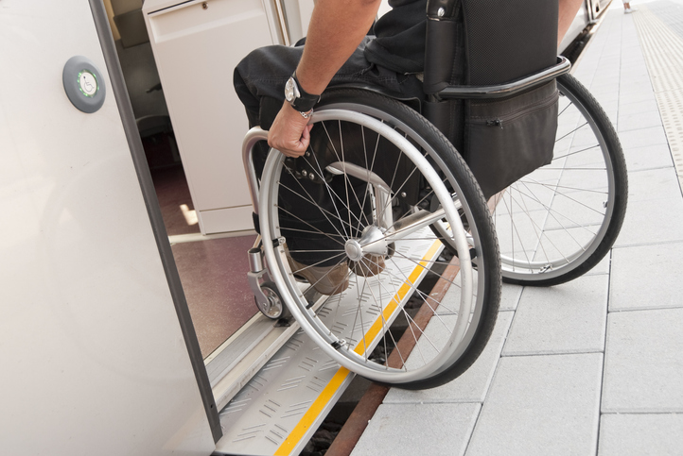
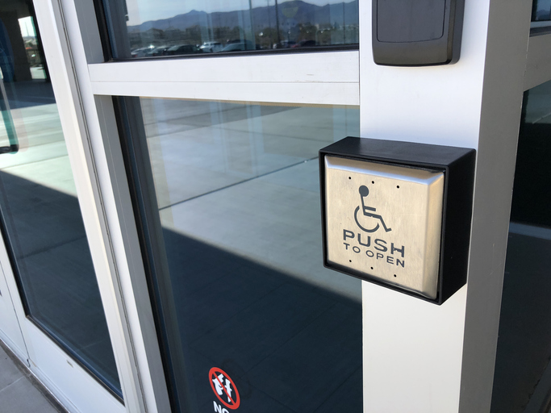
Live Event Considerations — Facility
Appropriate signage
Include QR code – AT accessibility
Accessible paths of travel
Mobility aids
Personal bubble/social distancing
Elevators
Well-marked emergency egress procedures
Accessible restrooms
Accessible parking and curb cuts
Relief area for service animals
Accessible registration area
Adjustable lighting and temperature

Slide 6
Live Event Considerations — Training Room
Accessible speaking platform
Separate microphones for multiple speakers
Speaker instructions
Repeat audience questions into microphone
Lavaliere/lapel microphone
Adjustable lectern
Provide assistive listening devices/hearing aid access
Lighting options
Seating arranged for mobility aid/service animal access
Multiple power outlets (e.g., to charge portable oxygen concentrator)

Slide 7
Live Event Considerations — Materials
Accessible videos and media
Consider accessible choices for font, color, and contrast
Include captions and audio descriptions early in production
Interpreter service (including deaf-blind)
Computer Access Realtime Translation (CART)
Alternate format (Braille, large print, electronic file, audio)
Consider going green
Accessible digital format or app

Slide 8
Live Event Considerations — Food & Beverage
Alternatives for dietary restrictions
Serving area arranged for mobility aid/service animal access
Avoid cross-contamination when preparing and serving
Be prepared to provide assistance retrieving food and beverages
Seating arrangements for varying social distance needs

Slide 9
Live Event Considerations — Outings & Off-Site
Planners should also make any field trips or activities accessible to participants. This may include arranging accessible transportation, providing a guide, or allowing a personal assistant to join. Consider making a visit prior to the event to conduct a facility audit.
Don’t forget about accessible restaurants and hotel guest room accessibility.

Slide 10
Outside Training
Employer must provide RA for equal opportunity to participate in employer-sponsored training, absent hardship.
In-house training
Training provided by outside entity
Both employer (Title I) and outside entity (Title III) have obligations to provide materials in alternative formats
Neither party should dodge accommodation obligations
Dual/shared obligations may exist
Specify responsibilities in contract before event
#15 EEOC Guidance: Reasonable Accommodation and Undue Hardship under the ADA

Slide 11
Personal Assistance Services on Travel
PAS services can be a travel-related accommodation in both Title I of ADA and 501 of Rehab Act settings.
Employers must consider paying additional costs related to providing PAS while on travel such as transportation costs for PAS.
Requirements for PAS when not on travel differ under Title 1 of ADA.
#14 Q&A: Federal Agencies' Obligation to Provide PAS under Section 501 of Rehab Act

Slide 12
Accommodation Examples

Slide 13
Hand Impairment Example
Situation: An employee with rheumatoid arthritis was presenting at a national conference on an expert panel. Typically, a standard microphone was passed from speaker to speaker amongst the panel.
The speaker made an accommodation request during conference registration, noting they could not grip and handle a traditional microphone.
Solution: The conference staff made sure the training room was equipped with a table mic along with a lapel mic, so the presenter had options once they arrived onsite.

Slide 14
Photosensitivity Example
Situation: A physician's assistant was attending a medical conference. Once they got on site, they noticed the facility used fluorescent lighting, which caused vision issues and migraines.
Solution: Since the need for accommodation wasn’t known by either party before the conference, the attendee opted to sit in the hallway of the training room where lighting banks could easily be turned off and they could listen to the presentation.
Better Business Practice: Be prepared to adjust lighting and have alternative options. Utilize presentation slides on conference mobile app or emailing to attendees beforehand. Permit self-regulated breaks, flexible seating, and alternate attire as needed.

Slide 15
Allergy Example
Situation: An attendee with a fragrance allergy was attending a work-related training. They were concerned about irritants once on site.
Solution: The attendee contacted the conference and learned that they were encouraging attendees to be fragrance-free during the event. The employee brought masks suitable for mitigating fragrance with them and took self-regulated breaks as a precaution. The attendee also asked if room doors could be left open for ventilation.
Better Business Practice: Encourage fragrance-free policies on registration materials. Maintain ventilation and consider air purifiers.

Slide 16
Hard of Hearing Example
Situation: An attendee who was hard of hearing wanted to attend a movie screening that was taking place at a social event organized by the conference. They contacted the conference to determine if captioning would be available.
Solution: The conference staff contacted the venue to ensure that captioning would be available to the attendee.
Better Business Practice: Ensure venues are following accessibility guidelines.

Slide 17
Toileting Example
Situation: A speaker with Irritable Bowel Syndrome was presenting at a professional development workshop. They were concerned about urgency to use the restroom during their hour-long session.
Solution: They made an accommodation request to the event planners asking for a presentation room near the restrooms. This enabled them to access the restrooms before and after their session as well as allowing the possibility of brief breaks if needed during their presentation.
Better Business Practice: Consider event locations with plenty of restrooms, build in break times within the schedule. Provide attendees with maps (paper and app). Temporarily modify restrooms based on accommodation needs.

Slide 18
Travel Example
Situation: An employee traveling for work wished to maintain independence. They had access to the Aira IO app for personal use but had not been permitted to use it at work.
Solution: The employer permitted them to use the Aira IO app for work-related travel in lieu of a Personal Assistant per the employee’s request.
Better Business Practice: Give primary consideration to employee’s first choice in accommodation options.

Slide 19
Nice-to-Haves

Slide 20
Better Practices for Events & Outings
Restroom availability
Gender-neutral
Family-style
Clear signage
Point of contact for access issues
Staff awareness and sensitivity
Contact information
Medical needs room
Nursing
Injectables
Refrigerator
Sensory-friendly areas
Soft lighting
Low noise
Fidgets

Slide 21
JAN Resources

Slide 22
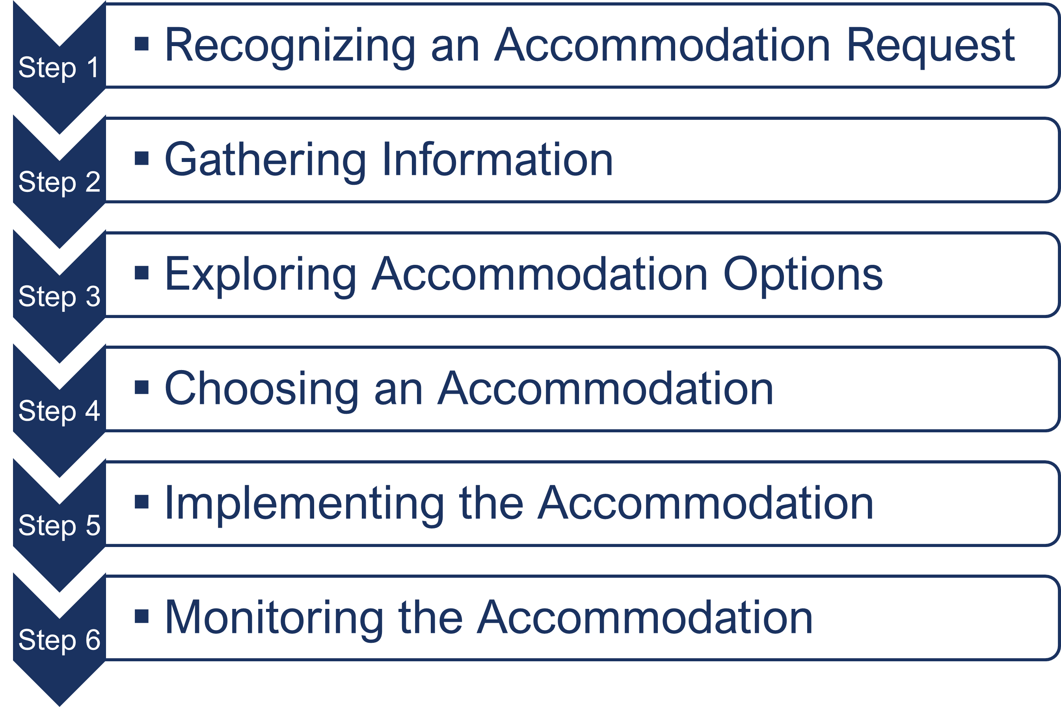
Interactive Process
A process for collaboratively identifying accommodation solutions AskJAN.org A to Z Topic: Interactive Process

Slide 23
AskJAN.org A to Z
A to Z of Disabilities and Accommodations

Slide 24
AskJAN.org by Disability

Slide 25
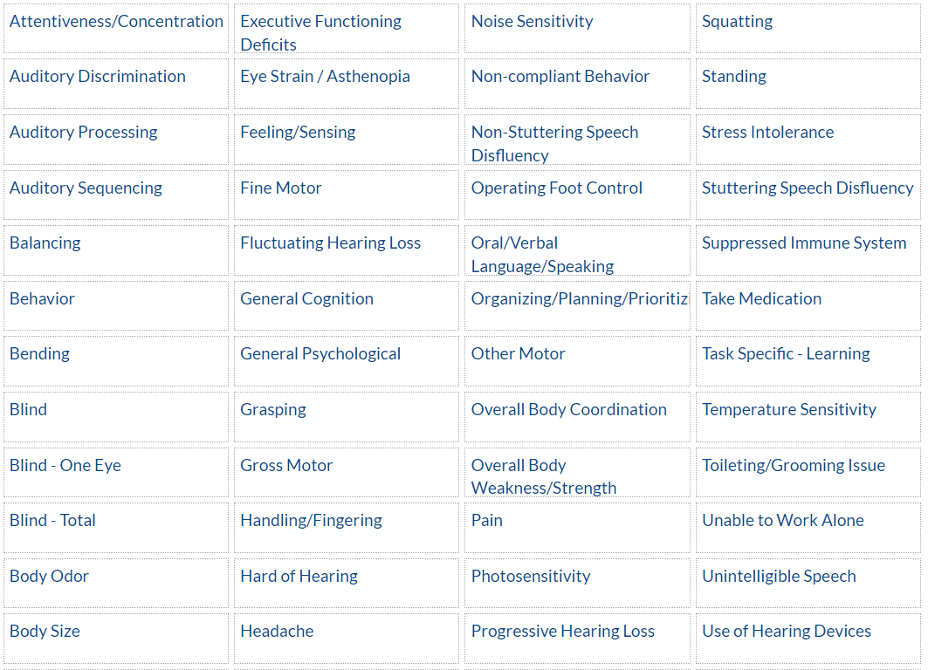
AskJAN.org by Limitation

Slide 26
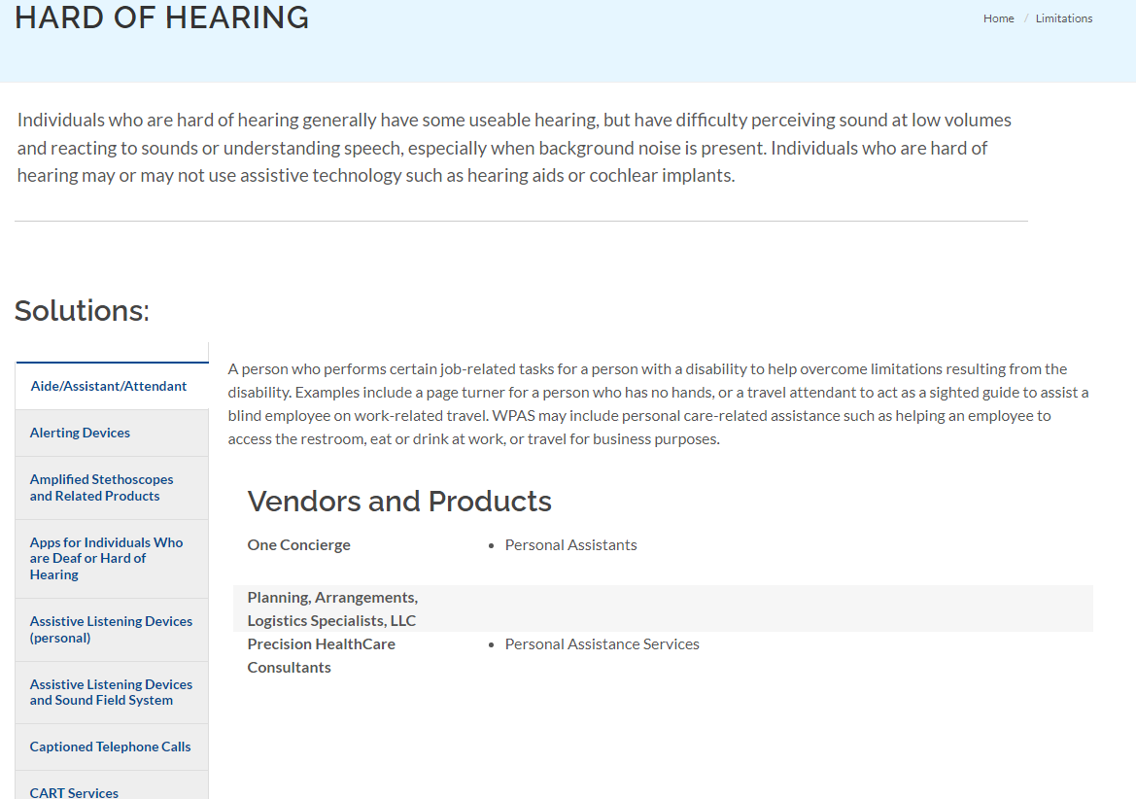
AskJAN.org by Limitation — Hard of Hearing

Slide 27
AskJAN.org by Topic

Slide 28
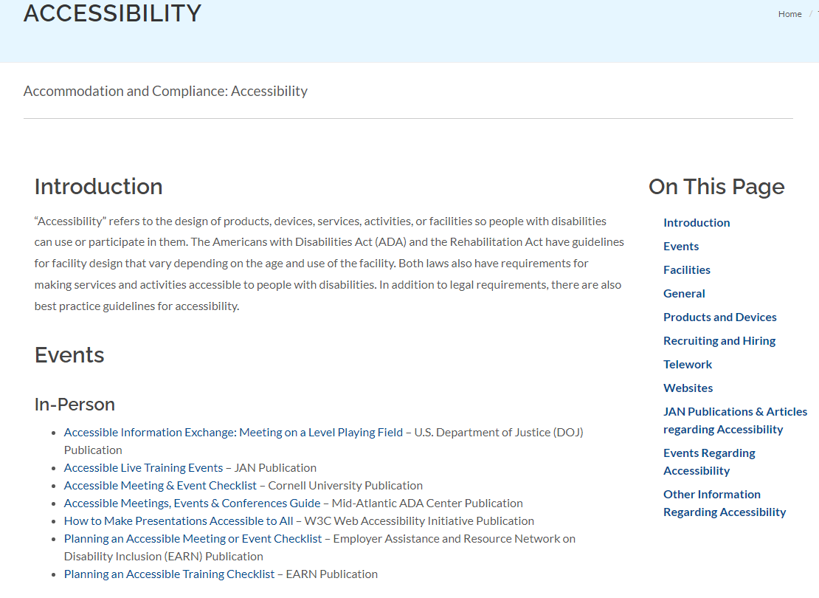
AskJAN.org by Topic — Accessibility

Slide 29
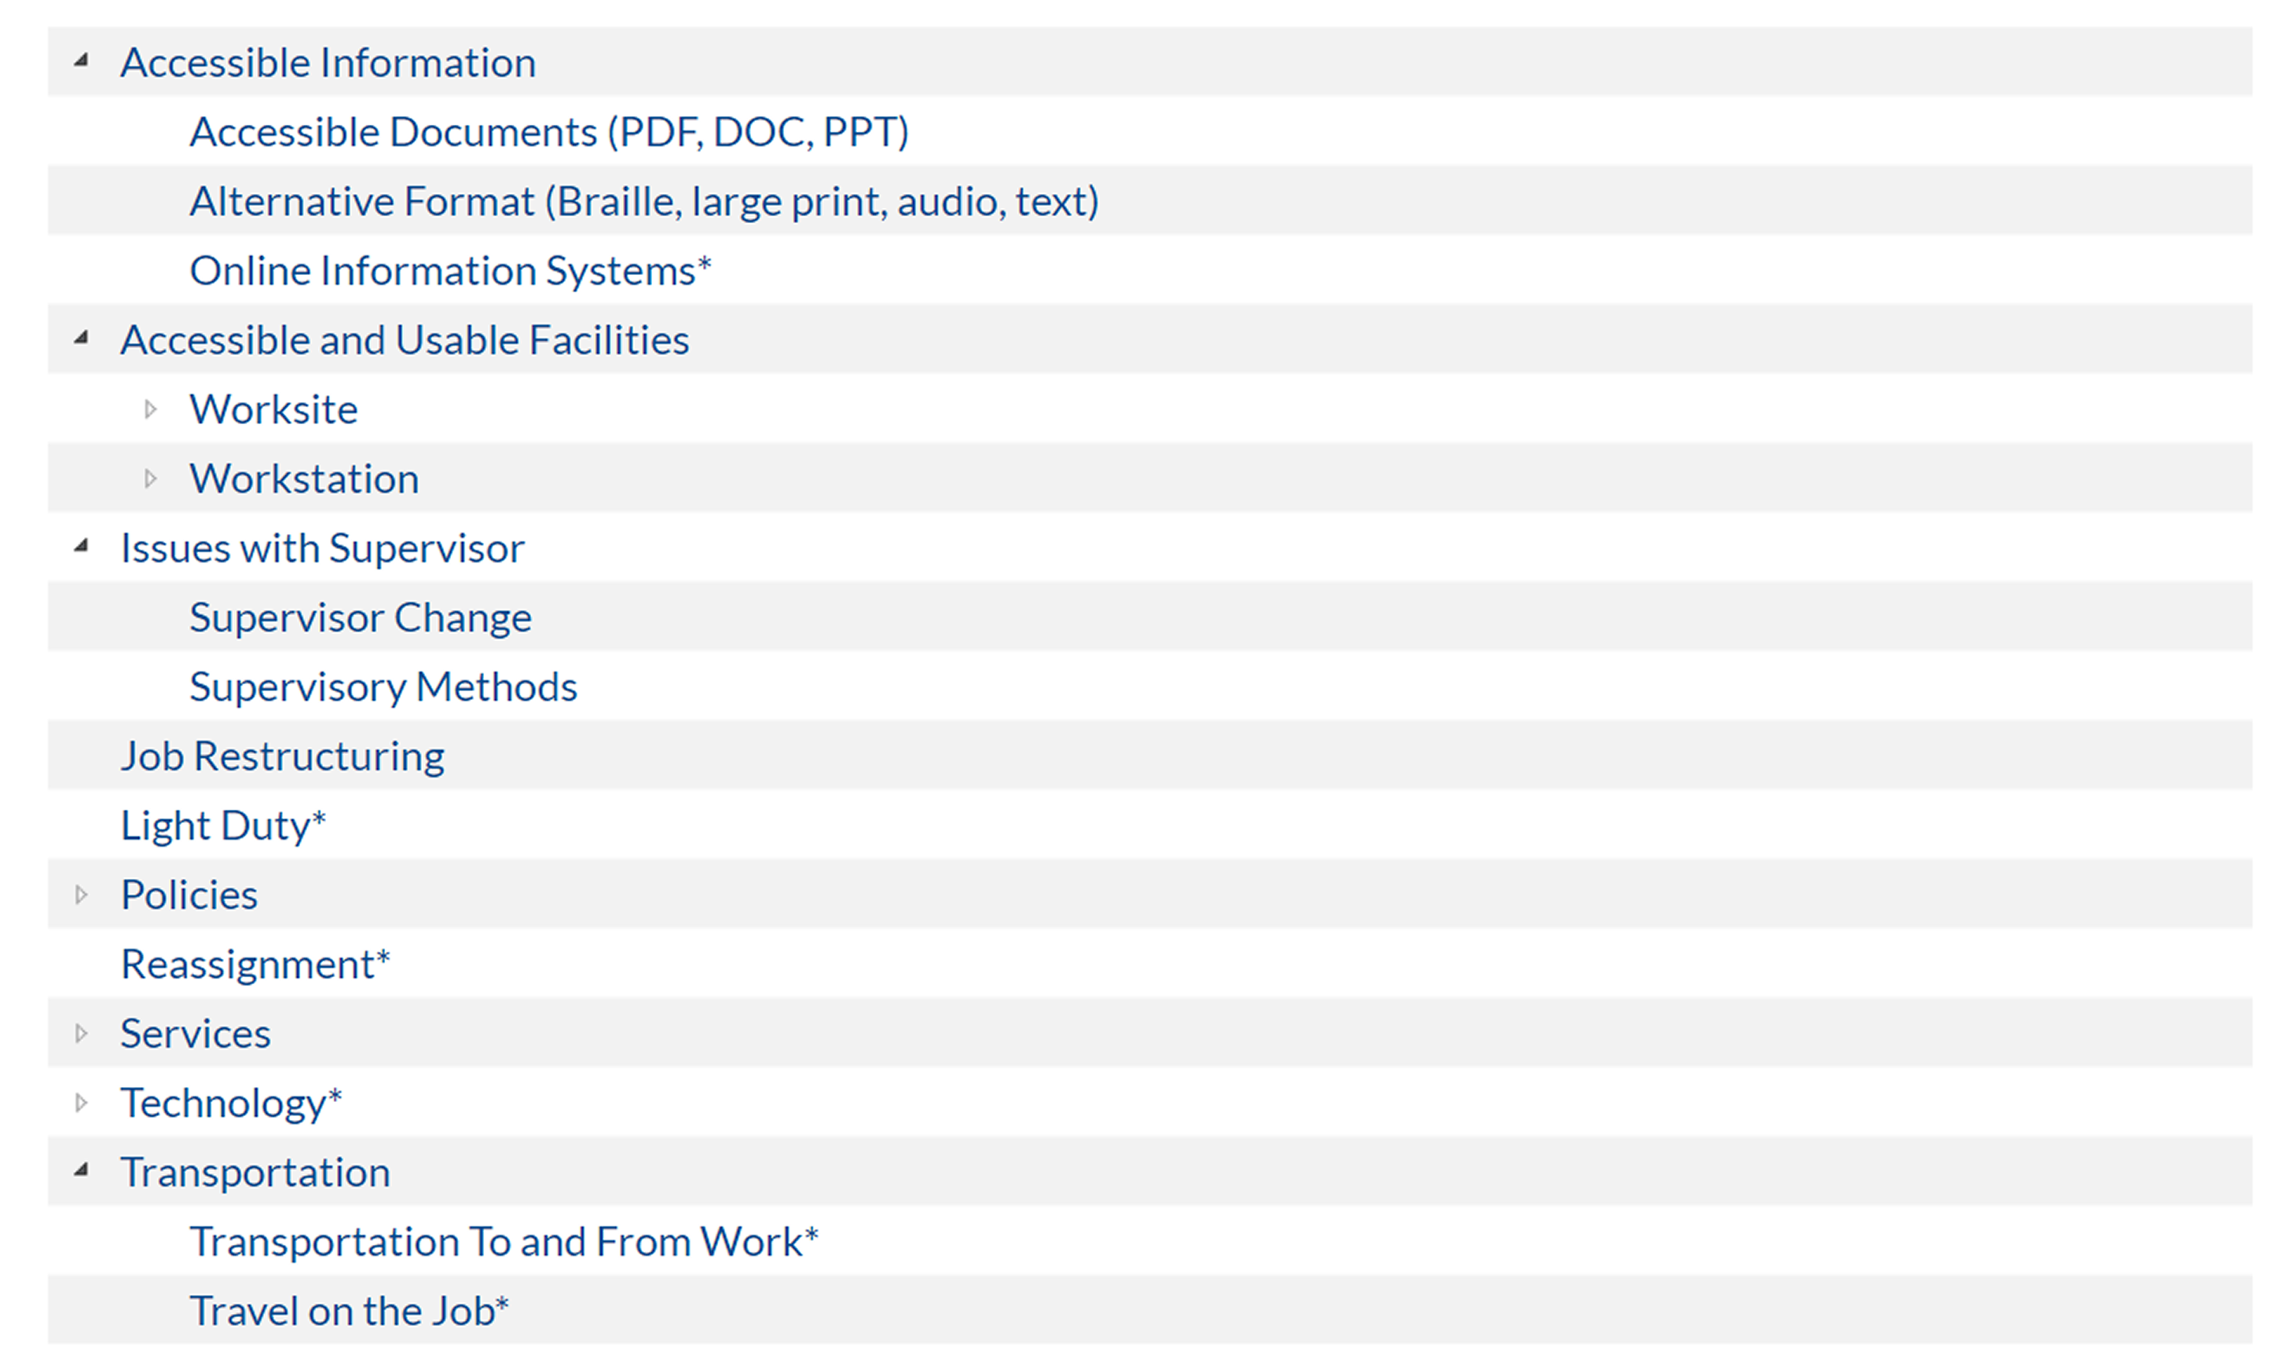
AskJAN.org by Accommodation

Slide 30
Contact JAN for More Information
Visit
AskJAN.org
Call
800.526.7234
877.781.9403 (TTY)
Chat
@ AskJAN.org
Submit
JAN on Demand Inquiry @ AskJAN.org/JANonDemand.cfm
Email
JAN@AskJAN.org
Social Media
Facebook – Job Accommodation Network
Twitter – @JANatJAN

