Slide 1
Low-Key AT —
Wearable, Mainstream, and Non-Obvious AT for Entry-Level Workers
Teresa Goddard
(800) 526-7234
(877) 781-9403 (TTY)
JAN@AskJAN.org

Slide 2
Speaker Disclosure
Teresa Goddard has financial relationships to disclose.
Receives salary from employment with JAN.
Teresa Goddard has non-financial relationships to disclose.
Teresa uses and has personal relationships with people who use various assistive technologies.

Slide 3

Objectives
  About JAN
  Hidden and Non-apparent disability
  Interactive Process and Choosing AT
  Situation and Solutions
  Questions
Notes:
Matt
I will begin our discussion today with an overview on the types of services that JAN provides. Then, I will take us through some of the common questions JAN consultants receive and the answers to those questions. Following this, I will go over JAN’s interactive process, and I will then take you through a tour of the JAN website. Finally, I will end by opening the floor to you all to ask any questions you may have on what we have discussed today. Because of this, I would appreciate it if you could hold any questions that arise until the end of the presentation.

Slide 4
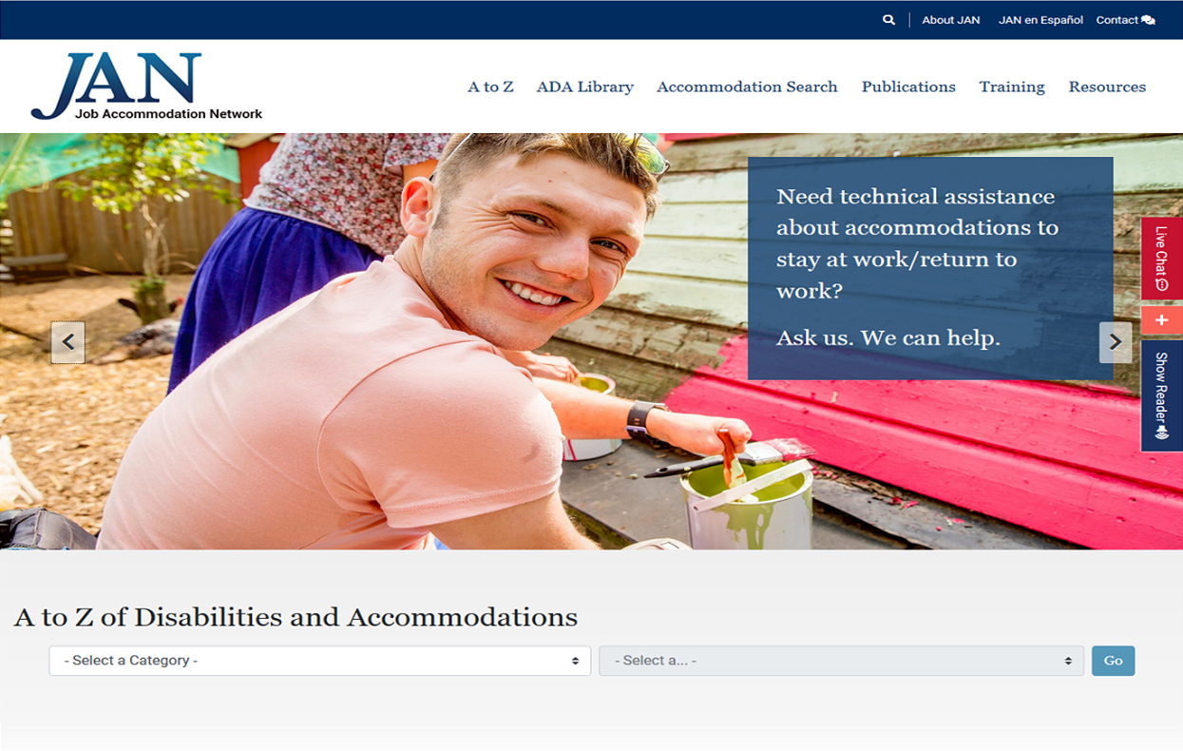
About JAN
Over 30 Years of Service
Consultation on:
  Job Accommodation
  Americans with Disabilities Act/Rehabilitation Act
  Entrepreneurship
Experienced
Free
National
Easy to Use
Confidential
Notes:
Matt

Slide 5
Non-Apparent Disabilities
Examples:
HIV/AIDS
Cancer
Diabetes
Heart conditions
Epilepsy
Sleep disorders
Respiratory impairments
Fibromyalgia
Brain injuries
Learning disabilities
Multiple sclerosis
Migraine headaches
Mental health impairments
Gastrointestinal disorders
Notes:
Teresa

Slide 6
Workplace Limitations
Standing for prolonged times
Maintaining balance
Keyboarding and mousing
Lifting materials or people
Concentration and memory issues
Working in extreme temperatures
Communicating with clients
Double vision/Visual acuity
Photosensitivity
Hard of hearing
Suppressed immunity
Notes:
Lisa
So looking at Workplace Limitations--- these are common limitations one who happens to have an autoimmune disorder may experience while on the job. Perhaps they have their personal life and home environment well managed but once on the job- have some of these limitations. Someone with autoimmune disorders may not have any limitations- someone may have just 1 limitation- or someone may have multiple. And this slide isn’t an exhaustive list of limitations one may have. There could be various others- but due to time– we thought this was a good start to those more common workplace limitations
I am not going to read them but you will see it will range from gross motor limitations- standing, lifting, to cognitive issues, concentration and memory- to sensory issues- the communication, the visual limitations, and of course something we are seeing more now than before- suppressed immunity.
Next slide

Slide 7

Misconceptions
Hidden disabilities are not as severe as obvious disabilities
Hidden disabilities are hard to accommodate
People with hidden disabilities do not need accommodations
Accommodations are expensive
Notes:
Lisa
So looking at Workplace Limitations--- these are common limitations one who happens to have an autoimmune disorder may experience while on the job. Perhaps they have their personal life and home environment well managed but once on the job- have some of these limitations. Someone with autoimmune disorders may not have any limitations- someone may have just 1 limitation- or someone may have multiple. And this slide isn’t an exhaustive list of limitations one may have. There could be various others- but due to time– we thought this was a good start to those more common workplace limitations
I am not going to read them but you will see it will range from gross motor limitations- standing, lifting, to cognitive issues, concentration and memory- to sensory issues- the communication, the visual limitations, and of course something we are seeing more now than before- suppressed immunity.
Next slide

Slide 8
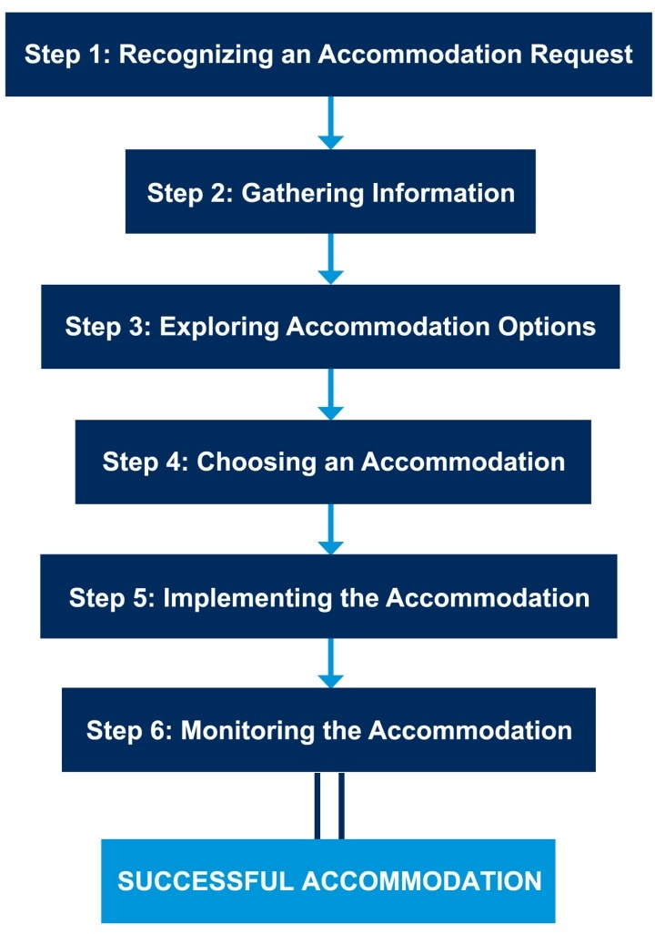
JAN’s Interactive Process
Notes:
Teresa
Short version

Slide 9

Step 4 — Choosing
  TIPS
Consider the employee’s preference
Consider a trial period
Keep lines of communication open
Notes:
Lisa
AT options for those activities of daily living-
Talking alarm clocks for reminder purposes
Medication management- this can be a reminder to take your next dose of medicine
We have vendor lists for grooming and dressing aids to help assist someone with physically putting on clothes
Thermal or cold wraps if the work environment is too hot or too cold causing pain and stiffness for employees
Reachers- love these for grabbing things from low or high places
Then grip aids for strength issues for gripping utensils or lids off things, or pencils/ pens
Next slide

Slide 10

Policy Example
JAN Example
An employee in a correctional facility used pre-filled insulin pens to treat diabetes. A new policy required all syringes to be left in vehicles outside the facility. This type of the medication can't be exposed to freezing temperatures or get too hot. It must be stored in a temperature-controlled environment.
Notes:
Note: this is a new warden with a new policy, not based on anything happening within the facility
Also, pre-filled pens are somewhat different from regular syringes.

Slide 11
Typical Approach
A typical approach is to see whether it would be possible to store the pen in a location that is acceptable by the employer while also meeting the employee’s needs.
For example, medication could be stored in a locker within the facility but outside the security checkpoint.
Notes:
While heating and cooling storage containers for vehicles do exist, it can be challenging to find one that will maintain a consistent temperature from inside a parked vehicle during extreme weather or for extended periods.
This approach may be combined with other accommodations such as regular breaks to check blood sugar.
School staff also utilize nurse’s station for storage-
Don’t accidentally throw away insulin from company fridge

Slide 12

What if?
The locker is far from the employee’s workstation, and they can’t gain access in a timely manner?
May need to retrieve it quickly to be effective
May have difficulty walking long distances during a diabetic emergency
May need related supplies
Retrieval draws unwanted attention
Notes:
This can apply to other conditions- food allergies, asthma, migraines
Monitors, testing supplies, lancets, all pose similar issues

Slide 13
Targeted Solution
What are some options to consider?
Find closer secure location
Develop a Plan of Action
Designate someone to retrieve supplies
Portable secure storage options
Relocate/reassign
If using medical device, consult manufacturer
Seek input from employee and physician
JAN’s Sample Plan of Action

Slide 14
Similar Issues
Due to recent advances in diabetic care, employees may need to wear wearable devices or access apps to monitor their blood sugar most effectively.
Why is this a problem?
Security concerns
Rigid workplace policies
Infection control protocols
Lack of effective alternatives
Notes:
Security concerns re: wireless technology
Emphasize mod policy first
This can be an issue in workplaces that restrict use of personal devices and wireless technology. Employers may need to consider policy modifications when possible or consider alternative accommodations.

Slide 15

Memory Challenge
JAN Example
  A retail employee with an intellectual disability had difficulty remembering when to take his breaks and lunch and when to return to his position.
Notes:
Teresa

Slide 16

Memory Solution
Accommodation
Using a programmable watch, the job coach helped set the times for his lunch and breaks and when it was time to return to work. The watch was set to vibrate so the employee knew exactly when it was time to leave for breaks and lunch and when to return to the sales floor.
Notes:
Teresa

Slide 17

Brain Fog Challenge
JAN Example
  A bus driver with Hashimoto’s Thyroiditis was performing well in his day-to-day work but tended to miss or be late to meetings required by his employer. When the employer approached him about the issue, he said the brain fog was causing him to forget about the meetings or to lose track of time when his daily routine was interrupted by a meeting.
Notes:
Teresa

Slide 18
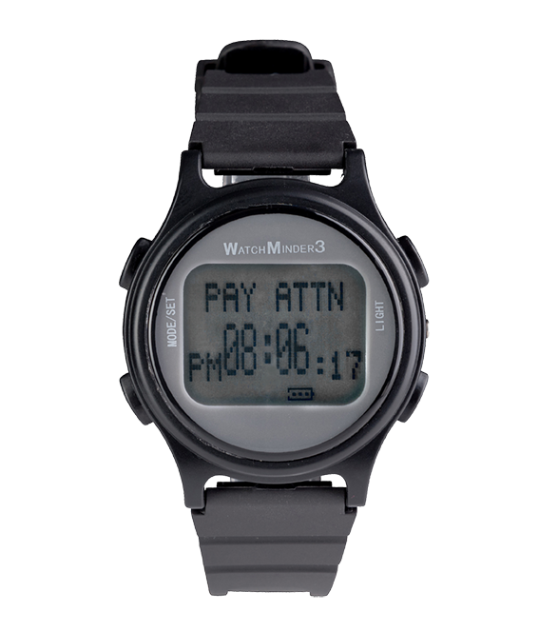


Brain Fog Solution
Accommodation
The employer provided emailed reminders, but the employee was forgetting to check his email. The employer provided a smartwatch so that email notifications and meeting reminders could be received on the employee’s wrist.
Notes:
Teresa

Slide 19
Interruption Challenge
JAN Example
A grocery store stocker was having difficulty remembering what tasks to return to when he was interrupted by customers asking for assistance or when he was called to another task such as cleaning up a spill.
Notes:
Teresa

Slide 20

Interruption Solution
Accommodation
The stocking clerk was given a small pen recorder that he kept in his pocket. When the current task he was engaged in was interrupted, he would record exactly what he was doing and where he was so that he could return to the task.
The pen recorder was discreet enough to not draw attention from colleagues or customers.
Notes:
Teresa

Slide 21

Heat Tolerance Challenge
JAN Example
A factory worker with myasthenia gravis was more susceptible to fatigue when he felt too warm.
Notes:
Teresa

Slide 22
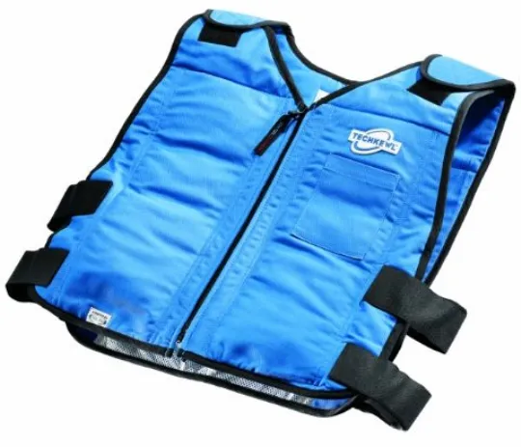
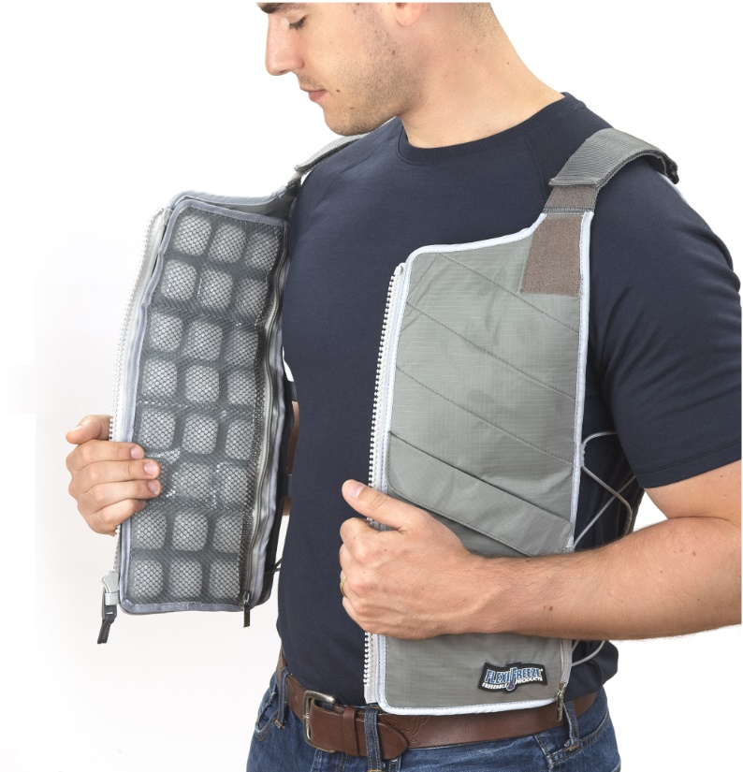
Heat Tolerance Solution
Accommodation
The employer provided a cooling vest which could be worn under a uniform or shirt.
Notes:
Teresa

Slide 23

Cold Tolerance Challenge
JAN Example
A new hire at a call center was having a hard time keeping up with case documentation due to finger numbness stemming from Raynaud’s syndrome.
Notes:
Teresa

Slide 24
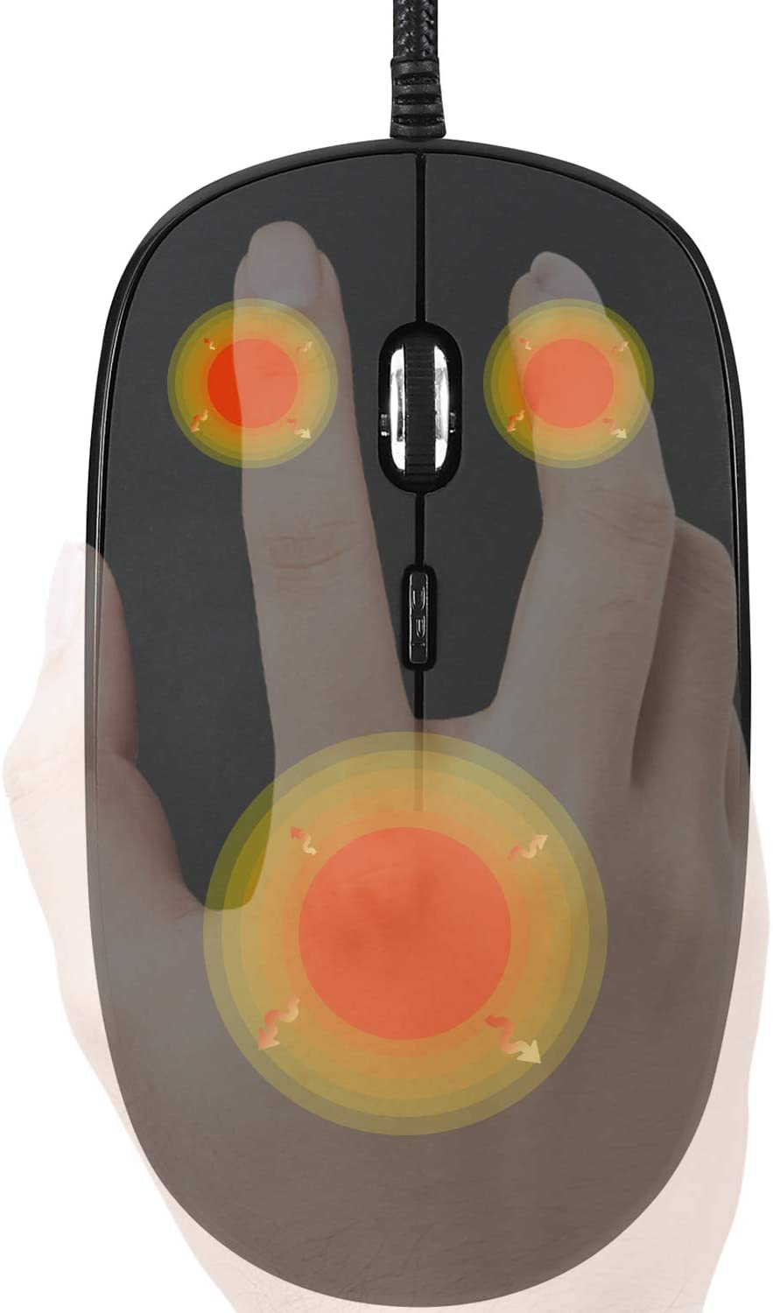

Cold Tolerance Solution
Accommodation
The new hire was provided with heated computer equipment which warmed her hands, enabling her to continue working and typing as needed.
The Wonders of Winter - Accommodation Options for Cold Weather
JAN Vendor List: Heated Ergonomic & Computer Products
Notes:
Teresa

Slide 25

Pain Challenge
JAN Example
A paralegal with cubital tunnel syndrome would feel a burning sensation when typing for long periods of time.
Notes:
Teresa

Slide 26
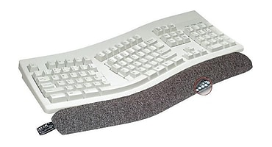
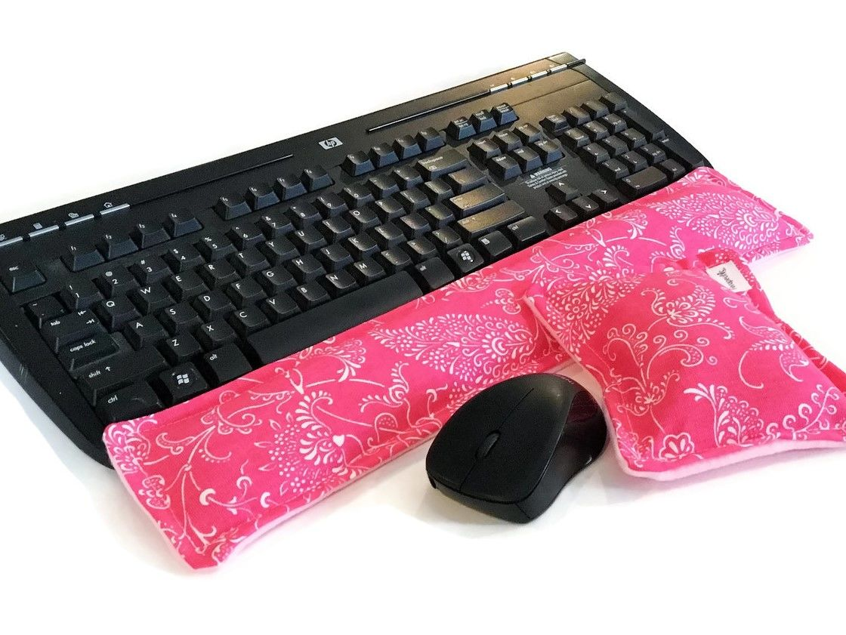
Pain Solution
Accommodation
She was concerned with privacy issues with speech recognition so opted to request a cooling wrist rest and mouse pad, which provided some relief while working.
Notes:
Teresa

Slide 27
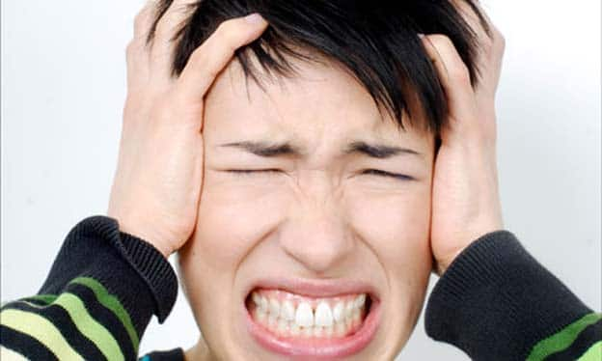
Noise Challenge
JAN Example
A secretary with misophonia was sensitive to the clicking sounds of the keyboard and mouse. Hearing the clicks would cause a panic attack and result in a loss of productivity.
Notes:
Teresa

Slide 28
Noise Solution
Accommodation
The employer provided the secretary with a new keyboard and mouse that were specifically designed to create minimal to no sound when in use. This enabled the employee to be productive without exacerbating the medical condition.
Misophonia: Sensitivity to Sounds & Survivng the Workplace
JAN Vendor List: Quiet Office Equipment & Supplies
Notes:
Teresa

Slide 29
Hearing Challenge
JAN Example
An insurance salesperson was hard of hearing. They were successful in their role and could hear well using their personal hearing aids for their day-to-day tasks. The only time they had trouble hearing was during full staff meetings when people were sitting around a large conference table. The employee explained her concerns to her boss.
Notes:
Teresa

Slide 30
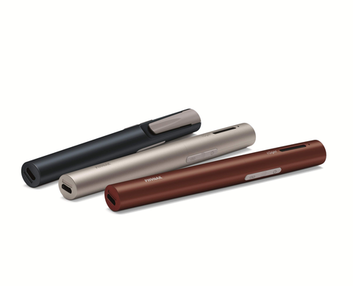
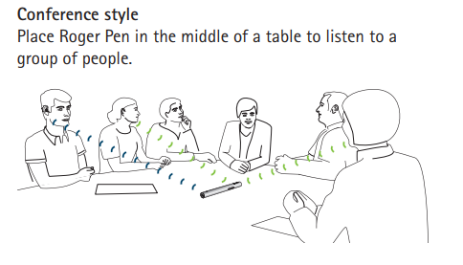
Hearing Solution
Accommodation
The insurance agency provided a Roger Pen for monthly staff meetings. The employee set it up on the conference table, and it streamed the audio directly to her hearing aids with a Roger receiver.
Notes:
Teresa

Slide 31

Photosensitivity Challenge
JAN Example
  A claims adjuster had mild vision loss and photosensitivity, which would cause a headache when the computer screen was too bright.
Notes:
Teresa

Slide 32
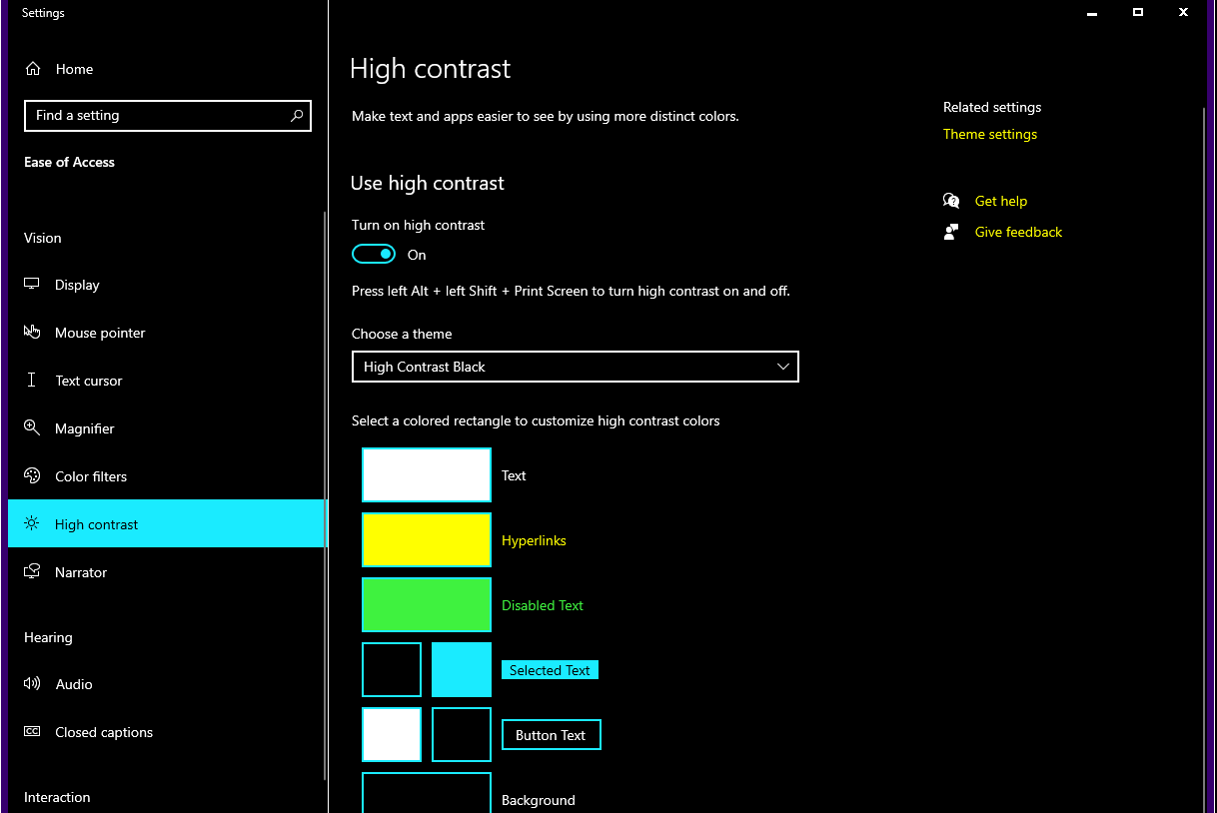
Photosensitivity Solution
Accommodation
When the employee would start to get a headache, they adjusted the built-in settings on their computer to high-contrast settings.
Notes:
Teresa

Slide 33
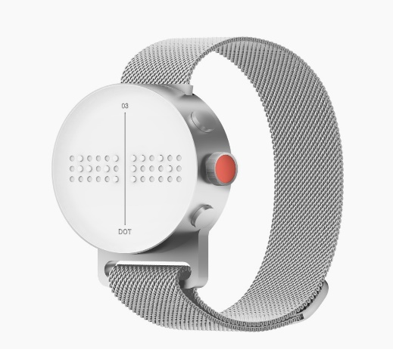
Braille Notifications
Dot Watch
Notes:
Teresa

Slide 34
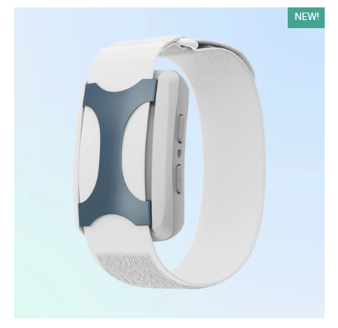
Manage Energy Levels
Apollo Neuro
Notes:
Teresa

Slide 35

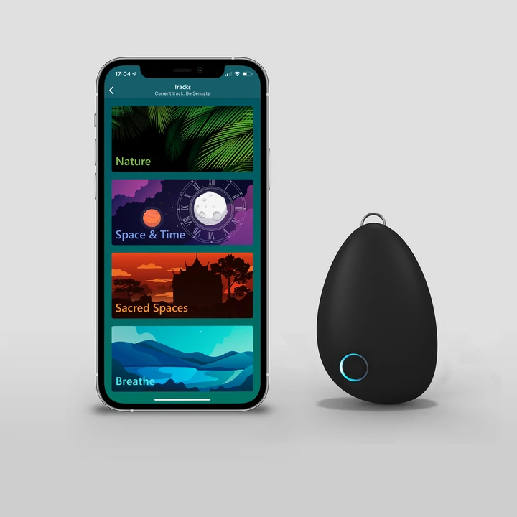
Manage Stress
Sensate
Notes:
Teresa

Slide 36
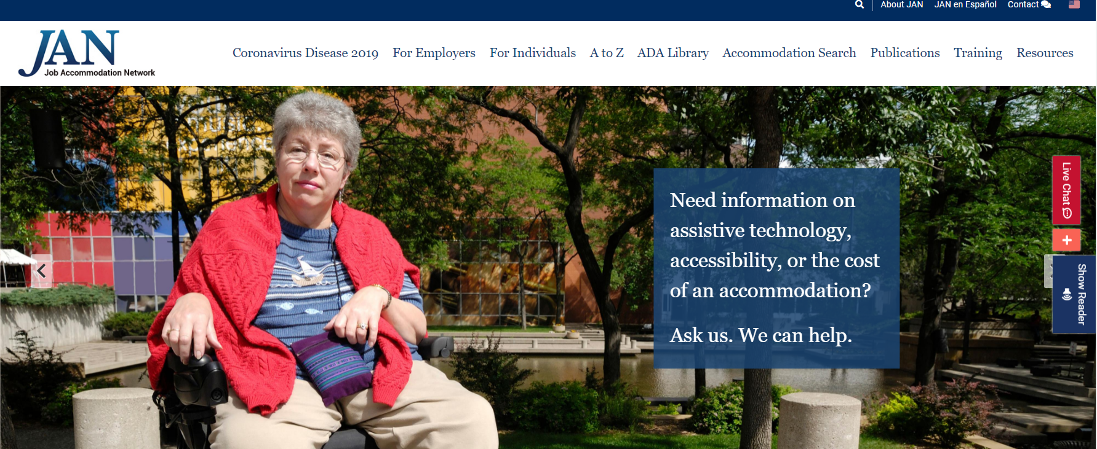
Visit AskJAN.org
Need information on assistive technology? Ask JAN!
Notes:
Matt to Tracie Q&A

Slide 37
AskJAN.org Resources
A to Z of Disabilities and Accommodations
https://AskJAN.org/a-to-z.cfm
By Topic:
  Disability Disclosure
  Interactive Process
  Medical Exams and Inquiries
  Online Applications
  Sample Forms
  Testing Accommodations
  Publications and Articles
  https://AskJAN.org/publications/index.cfm
  Accommodation Scenarios for the Interviewing Process
  Job Application/Interview Stage Dos and Don’ts

Slide 38

JAN Homepage
Notes:
Here is an image of the new JAN homepage. We recently rolled out a new website design! So, if you have used us in the past and squirreled away some links to resources you commonly use, then you may find that those links no longer work.
However, one of the major benefits of the website redesign is that we made some of our more commonly used features much easier to access. One of those commonly used features was our A to Z lists of Disabilities and Accommodations. You can assess this feature directly from our homepage near the bottom of the page **click to transition in arrow** or by clicking on the A to Z link at the top of the page if you are elsewhere on the site **click again to transition in the circle**.

Slide 39
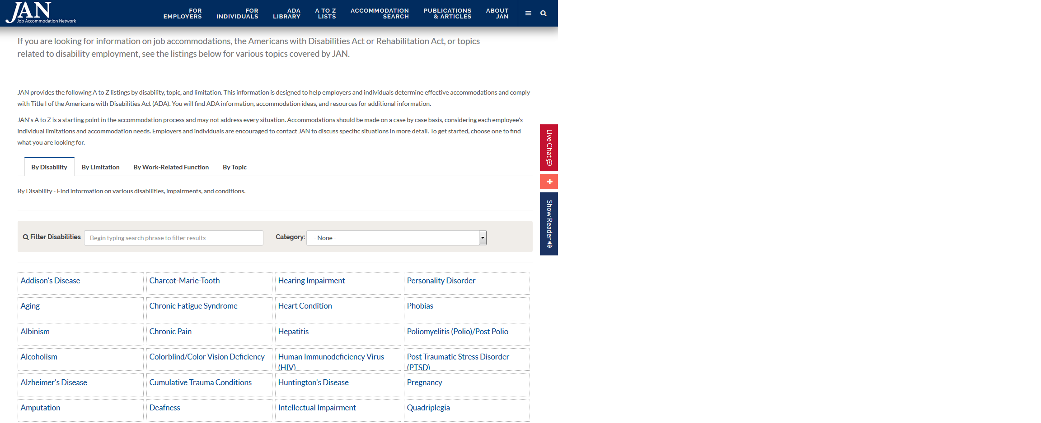
A to Z Lists
Notes:
This is a screenshot of what the A to Z page looks like if you choose to use the link at the top of the page rather than the drop down menu on the main homepage. You can easily switch between By Disability, By Limitation, Work-Related Function, and Topic by clicking on the tabs near the middle of this page **click**. You cannot see it on this screenshot, but the page continues much further down with even more links to review.
Next, let’s take a look at the ADA Library **click** where you can find various links that describe the ADA and the 5 titles it is divided into, as well as the ADA Amendments Act.

Slide 40

ADA Library
Notes:
Here is a screenshot of the top of the page for the ADA Library. On the right side of the screen, you will see a sort of table of contents. If you click on one of the links with this table, it will automatically scroll the page down to the area where that topic is discussed. Just like with the last slide, you cannot see it but this page continues much further down as well.
Next, let’s take a look at where you can find an index of all of our publications and articles **click**. This is especially useful if you are in the boat I talked about earlier in that you have links squirreled away that no longer work, as this is likely where you will find those items again.

Slide 41

Publications & Articles
Notes:
Here is a screenshot of the beginning of our index page for our various publications and articles. Just like with the ADA Library page, there is a table of contents on the right side of the screen to help you quickly move through the various sections of the index. In addition, there are filter options at the top **click** that allow you to only show the newest articles to be added to the page, to only show the most commonly accessed articles, or to show all of the articles in the index. Naturally, the screenshot on this slide does not come close to showing all of the publications contained on this page.
Now, let’s end the website tour with a look at our new Accommodation Search feature **click**. For those JAN site veterans out there that are very used to our SOAR feature, this is akin to an updated version of SOAR.

Slide 42

SOAR Accommodation Search
Notes:
Here is a screenshot our new SOAR Accommodation Search page. On the right side of the screen **click**, you can find some of our most popular searches. If you are looking for accommodation ideas on one of those topics, simply click on the corresponding button and SOAR will perform a search for you. However, if there isn’t a button for what you are looking for you can instead type in whatever it is your are looking for on the left side of the screen **click** and click search manually.
As an example, let’s say you are searching for our vendor listings for office chairs. You type in “Office chair” into the field on the left hand side of the screen and click search.

Slide 43

Search Results
Notes:
Here is an example of what you will see once you click search. On the left side of this screenshot, you will see options to narrow down your search results **click**. There are various options you can choose from but this screenshot only captures three of the options. However, we don’t need to worry with that in this case because the search has what we are looking for listed as the 2nd result of our search **click**. So, let’s click on that.

Slide 44

Vendors and Products
Notes:
Here you find a description of what the product is, and some example situations it may be helpful to consider it as an option **click**. The listing of vendors and some example products from those vendors can be seen near the bottom of the page on the left hand side **click**. On the right hand side of the screen you will find a section titled related content **click**. Here you can find links to other pages on the JAN website that lists this page as a possible accommodation solution. This way, you can easily make your way to pages that can contain other accommodation options that you may find helpful to review as well.

Slide 45

Questions?

Slide 46

Contact JAN
Visit AskJAN.org
Submit a JAN on Demand question @
AskJAN.org/JANonDemand.cfm
Email JAN @ JAN@AskJAN.org
Use the JAN Live Chat @ AskJAN.org
Leave a voicemail message.
JAN staff will contact you via email or a call:
  800.526.7234 (V)
  877.781.9403 (TTY)
Connect on social media
  Facebook – Job Accommodation Network
  Twitter – @JANatJAN

